Slide 1
UNIDO‘s 7th LDC Ministerial Conference
“ Building global partnerships: Enhancing growth and inclusivness in LDCs ”
Session 1 – Partners Dialogue
“UNIDO’s perspective”
A presentation by Mr. Hiroshi Kuniyoshi
Deputy to the Director General

Slide 2
Context:
Since IPoA in 2011 only two LDCs graduated : Samoa and Equatorial Guinea
Angola and Vanuatu expected to graduate by 2021.
Only 6 other LDCs meet 2 of the 3 criteria for the graduation: (Bhutan, Kiribati, Nepal, São Tomé and Príncipe , Solomon Islands and Timor-Leste)
The IPoA “aim of enabling half the number of LDCs to meet the criteria for graduation by 2020”
Some of the countries are Small Islands Developing State (SIDS) - especially exposed to climate change shifts and natural disasters

Slide 3
Needs towards sustainable graduation
A new partnership between all relevant development actors needs to be created to effectively:
Accelerate industrialization
Promote investment & innovation
Foster renewable energies and cleaner production
Entrepreneurship development
Strengthen the resilience of LDCs economies in front of economic shocks and disasters
Enhance Trade capacities and competitiveness
To better support LDCs UNIDO developed : UNIDO LDC operational strategy (2011-2020).
Moreover UNIDO’s revamped its mandate :
INCLUSIVE AND SUSTAINABLE INDUSTRIAL DEVELOPMENT (ISID)

Slide 4
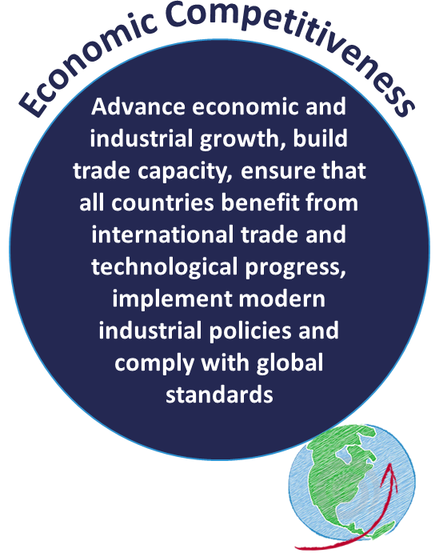
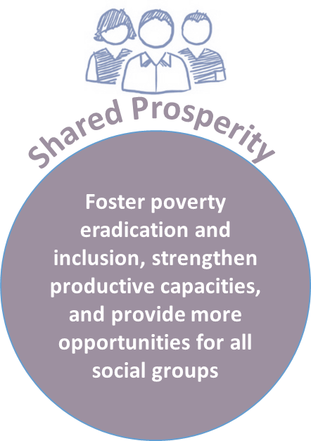
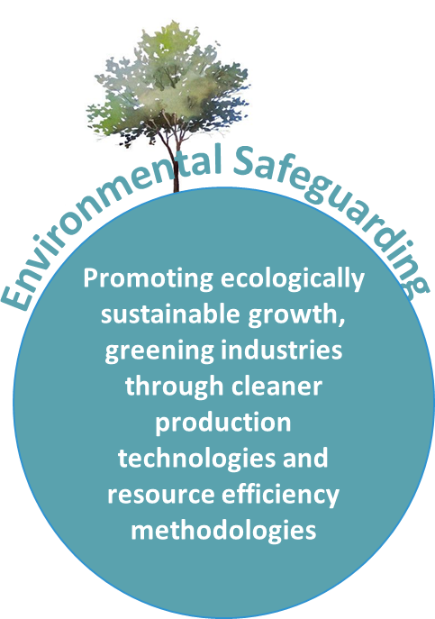
Inclusive and Sustainable Industrial Development
Cross-cutting issues: industrial policy advisory role; South-South and triangular cooperation; gender equality and women's empowerment; etc.

Slide 5
ISID and the IPoA:
IPoA Priority areas | UNIDO’s Technical Assistance
Productive capacity | Strengthening Agro Industries Value Chains and Supplier Development Renewable and rural energy (mini-grids)
Agriculture, food security and rural development
Trade | Clusters, export consortia and business linkages Competitiveness, upgrading and modernization Quality and compliance infrastructure
Commodities | Clusters, export consortia and business linkages Competitiveness, upgrading and modernization
Human and social development | Productive work for young people and Entrepreneurship development Gender and Women’s empowerment/employment programmes
Multiple crises and other emerging challenges | Green Industry solutions and circular economy; Resource management Post-crises intervention-sustainable livelihood programmes Renewable and rural energy Energy efficiency and cleaner production
Mobilizing financial resources for development and capacity-building | Development of Programme for Country Partnership (PCPs) Partnering with DFIs and other multilateral funding agencies (GEF, MP) Partnership development with the private sector (PPPs) Investment and technology promotion (ITPOs)
Good governance at all levels | Industrial Policy advice Capacity building

Slide 6
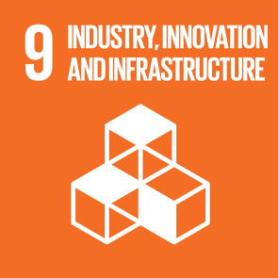
ISID as a global priority:
UNIDO’s ISID within the 2030 Development Agenda:
SDG 9: “Build resilient infrastructure, promote inclusive and sustainable industrialization and foster innovation”
Industrialization is crucial in reaching other SDGs :
Directly participate to:
Eradicating poverty (SDG 1)
Food security (SDG-2)
Affordable and clean energy (SDG 7)
Decent work and economic growth (SDG-8)
Climate action ( SDG 13)
Partnership for the goals (SDG 17)
Strongly support :
Quality education ( SDG 4)
Gender equality (SDG 5);
Reduce inequalities (SDG 10);
Responsible consumption and Production (SDG 12);
Sustainable livelihoods (SDG-11)

Slide 7
The pivotal role of partnerships
SDG 17: “revitalize the global partnership for sustainable development”
UNIDO developed a partnership based approach to mobilize additional resources from various partners
This approach aims to :
mobilize external partners and additional resources
extend the impact of UNIDO’s technical cooperation and
accelerate ISID in Member States
To increase its impact on the ground UNIDO developed partnership with :
Governments
Development finance institutions (DFIs)
UN agencies
Multilateral / bilateral development agencies
Civil society
Private sector

Slide 8
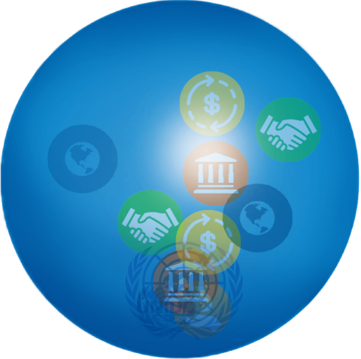
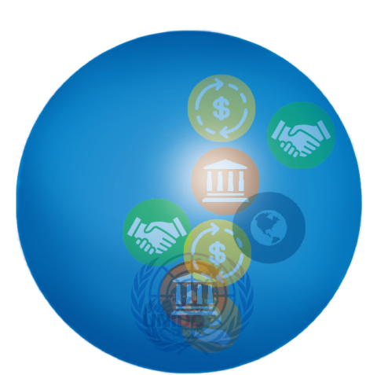
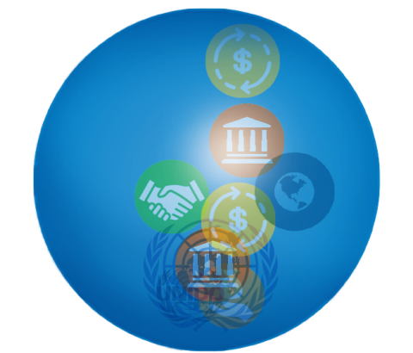
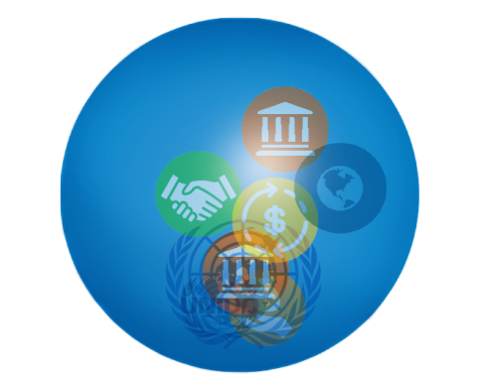
UNIDO Partnership approach :
Leveraging TC for large scale investment flow
Normal project cycle
PCP approach – countrywide program support the government to scale-up best practices
project development / Identification
• 30–50.000$ • Resources: UNIDO (seed money)
project program / Implementation
• 1–5 Mio.$ • Resources: UNIDO, donors (government, public and private partners)
project development / Identification
• 30–50.000$
• Resources:
UNIDO (seed money)
project / program Implementation
• 1–5 Mio.$ • Resources: UNIDO, donors (government, public and private partners)
Scaling up best practices / Investment
• 20–400 Mio.$ • Resources: Development finance institutions, UN system, Private sector, bi- and multilateral development partners

Slide 9
The way forward
Further develop synergies between all relevant partners especially the Private Sector in order to harvest the necessary resources and ensure greater financing .
Upscale multipartite innovative partnerships .
Mainstreaming sustainable and inclusive industrialization within National and Regional policies to boost the graduation process
Foster the inclusion of the vulnerable segments of the population, especially youth and women.
.Encourage circular economic production methods to mitigate industrialization’s environmental impacts.
Agree on the 7th LDC declaration to further align and strengthen complementarities between all recent frameworks to ensure growth and inclusiveness for all.

Slide 10
Thank you for your kind attention!
For further information please access:
www.unido.com/ldc2017
and
https://isid.unido.org/index.html

