Slide 1
Economic empowerment of women in green industry: insights from Peru, Senegal, South Africa and Cambodia
March 2022

Slide 2
Overview
Methodology
Feminist critical policy analysis
Key findings from desk research and mixed methods approach
Recommendations

Slide 3
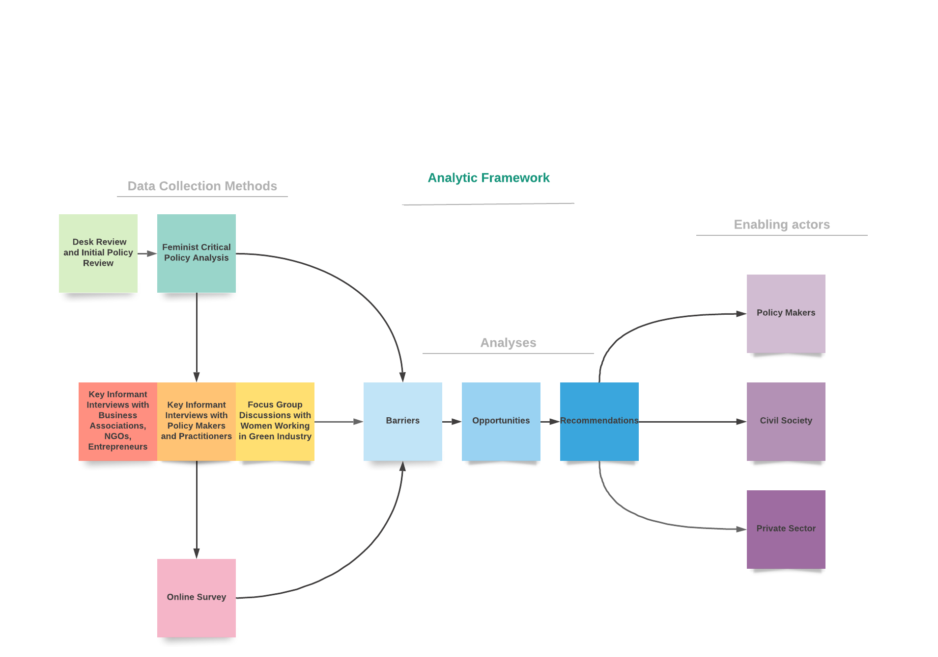
Notes:
The research study used a mixed-methods approach combining qualitative and quantitative data collection.
All data was collected in January-March 2020.
The draft report was subjected to iterative review and comment by country steering committees before finalisation.

Slide 4
We spoke with 361 people in the 4 countries
Notes:
An online survey was distributed to women in green and conventional industries across all four countries.

Slide 5
Sectors | Sub-sector
Cambodia
Garment, textile and footwear
Agribusiness | Organic agriculture and transformation of agri-foods
Energy | Solar
Tourism | Hospitality and restaurant
Peru
Textiles | Tanneries for leather and footwear Industries
Agro-foods | Coffee and cocoa
Waste management | Waste recycling
Senegal
Energy | Mixed energy combining electricity, solar, wind, and biomass energies
Agribusiness | Organic agriculture and transformation of agri-foods
Animal husbandry and production | Leather and animal skin
Fishing | Fish processing
South Africa
Renewable energy | Wind and solar
Waste management | Plastics
Land transport | Road transport
Industrial sectors and sub-sectors
Notes:
The selection of sectors and sub-sector was based on collaborative discussions between the project’s National Coordinators, UNIDO country representatives and the National Focal Points. Potential synergies with Programme for Country Partnership (PCP) projects and the alignment with the government’s priority sectors were taken into consideration. In Peru, Senegal and South Africa an analysis was also performed using a points matrix that evaluated each sector and sub-sector in five (5) main aspects: (1) gender mainstreaming and of the role of women; (2) market size and potential; (3) entrepreneurial level; (4) environmental consciousness of sector players; and (5) potential synergies with PCP projects. Each sub sector was assigned points for indicators under each aspect. The sub sectors selected were those with the highest scores.
Check text against 2nd edit submitted to UNIDO

Slide 6
Most of the policies reviewed in the four countries did not meaningfully engage with gender issues and engage gender perspectives. Key recommendations:
revisiting policies;
revisiting and developing specific M&E frameworks that collect baseline sex-disaggregated data;
revisiting policies to ensure the differential needs of women are meaningfully included in policies;
conducting mid-term evaluations that will help contextualise the progress of the policy.
Feminist critical policy analysis

Slide 7
In all countries, there is currently limited evidence on women’s empowerment and involvement in green industry.
This is a problem given the existing gender inequalities in entrepreneurial roles in green industry that are expressed both overtly and covertly in discriminatory practices.
Findings from primary data collected
Notes:
However, more women are becoming or aspiring to become entrepreneurs in the green industry than in conventional industries and there is a strong perception that there are more opportunities for women to progress on an equal playing field in green industry.

Slide 8
Percentage of green entrepreneurs who operate their businesses full-time (%)

Slide 9
Barriers to starting a green business
The high costs associated with business startup
Unavailability of technology and lack of awareness about starting a business
There is no clear-cut definition of “green industry”
Due to lower production costs, products manufactured by “conventional industries” are often less expensive
There is lack of incentives for businesses operating in green industries
Findings from primary data collected

Slide 10
The barriers for women entrepreneurs to succeed in green industry were similar across all countries targeted.
Barriers to advancement
Barriers to Transformation
Lack of awareness about policies, programmes and opportunities;
Lack of access to technology, market, capital, collateral and credit resources, network, mentoring;
Lack of necessary skills.
Harmful social norms;
Restricted mobility;
Unpaid care work;
Intersectional inequalities;
Discriminatory hiring practices;
Lack of self-confidence;
Low access to right to information.

Slide 11
“But if all the assets are in the name of their husband and you need a collateral then you need husband’s support to get bank loan. You (a woman) can get bank loan independently as long as you comply with the condition of the bank. You need to have a land or a building that you can, you know, put as a collateral. So, if everything is in the name of your husband, what can you do?” - KII, Woman, Executive Director, NGO, Phnom Penh, Cambodia.

Slide 12
Opportunities for the green industry professionals
Generating visibility and role-models
Strengthen opportunities for women in certain sectors such as renewable energy and green industry
Mentoring and networking.
Notes:
Cambodia: There are organisations like SHE investments, Impact Hub, EnergyLab, Pact Cambodia, Grow Asia, Cambodia Women Entrepreneurs Association (CWEA), Cambodia Women Business Federation (CWBF), Young Entrepreneurs Association of Cambodia (YEAC), UN agencies and others working for women entrepreneurs and providing them information, training, seed money for startups, online learning platform, mentorship.
Peru: There are several public-private or private initiatives that showcase accomplished women in the sciences or develop mentorship programs. For instance, the multinational IT company Cisco is developing a mentorship program for its employees. Moreover, L ́Oréal Peru, UNESCO and CONCYTEC have established the National Prize for Women in Science (Por las Mujeres en la Ciencia) to recognize the contribution that women in sciences make in Peru.
Senegal: ADEPME is the Agency for the Development and Coaching of Small and Medium Enterprises, an operational unit of the Ministry of Commerce. It accompanies small and medium enterprises who apply for or benefit from a government loan. Food Technology Institute (ITA) has a wide range of activities. a project from PNUD that distributes fodder women can use in their kitchen-garden perimeters for the production of food (for commercial purposes or for auto-consumption).

Slide 13
“I am seeing a lot of women who are interested, willing to learn and willing to have careers in the green industry space. I think the reason is that everyone wants to have a sense of having contributed. Most women inherently want to do just that, they want to contribute to the growth of the economy and the solutions to the energy issues in our country.” - KII, Woman, Vice Chair and Regional Project Manager, Pretoria, South Africa.

Slide 14
Key recommendations
Better understanding of the green industry business is needed.
The existing policies should be implemented well and linking or building on existing ministries’ relevant programs that could leverage integration of gender and green industry.
Capacity building (on design, planning and execution of green initiatives) of the local government institutions (for instance municipalities) who are responsible to execute the “green” laws.
Promote successful women entrepreneurs in green industry to be the ambassadors/role models to share their experience to generate interest and awareness among women and girls.
Notes:
(e.g. incentives available for women to enter green business; public awareness raising about green industry through training/campaign/TVET/information sharing; primarily focusing on small scale women entrepreneurs considering as a practical entry point to introduce the concept of “green industry”; job opportunities and support/incentives)

Slide 15
Key recommendations
Nationally representative data with robust monitoring and evaluation plans to track structural-level gender transformation at national level.
Capacity building for entrepreneurs (in management skills, conversion to green industry and gender mainstreaming, for example).
Development of a pipeline of relevant education and skills and promotion of entry level for women.
To develop more leadership and management skills for professional women.
Specialist technical skills development programmes for women entrepreneurs.

Slide 16
The recommendations selected by countries for their workplan are

Slide 17
Country specific recommendations: Cambodia
Awareness raising about what green industry is
Capacity building of national and local government institutions
Developing and implementing a policy framework to better integrate gender into new green industrial policies
Promoting women collaborative networks and exchange visits/programs
Developing/strengthening monitoring mechanisms
Systematically collecting more nationally representative gender disaggregated data.
Notes:
Some of the key recommendations from the Cambodia policy assessment report include the need for:
Awareness raising about what green industry is, what makes a business “green”, the industry’s economic, environmental and social benefits for everyone especially for women and existing laws;
Capacity building of national and local government institutions responsible for the development and implementation of “green” laws;
Developing and implementing a policy framework to better integrate gender into new green industrial policies;
Gender mainstreaming green industry current policies and programmes;
Promoting women collaborative networks and exchange visits/programs and increasing visibility of women entrepreneurs;
Developing/strengthening monitoring mechanisms to ensure gender-sensitive measures are not only included in the design and methodology, but changes are measured during the implementation of plans, strategies and policies;
Systematically collecting more nationally representative gender disaggregated data to better understand the different needs and opportunities as well as the impact of green industry’s growth on women and men.
Peru
Generate more awareness about the benefits of gender equality and women´s inclusion and augment the knowledge and capacities of policy makers in terms of gender mainstreaming.
Provide practical guidelines on how to apply and operationalize the Policy on Gender Equality in each sector prioritized. In general, capacity building programs should be practical and include a guideline on how to take the concept to practice.
Aim to develop a common understanding of key concepts and ensure policy makers are able to explain them.
Provide data that can help policy makers understand the economic opportunities the country is missing because of the limited participation of women as business leaders in the green industry.

Slide 18
Country specific recommendations: Peru
Generate more awareness about the benefits of gender equality and women´s inclusion and augment the knowledge and capacities of policy makers in terms of gender mainstreaming
Provide data that can help policy makers understand the economic opportunities the country is missing
Strengthening business network and access to finance
To mainstream the gender approach in prioritised policies.
Notes:
Some of the key recommendations from the Cambodia policy assessment report include the need for:
Awareness raising about what green industry is, what makes a business “green”, the industry’s economic, environmental and social benefits for everyone especially for women and existing laws;
Capacity building of national and local government institutions responsible for the development and implementation of “green” laws;
Developing and implementing a policy framework to better integrate gender into new green industrial policies;
Gender mainstreaming green industry current policies and programmes;
Promoting women collaborative networks and exchange visits/programs and increasing visibility of women entrepreneurs;
Developing/strengthening monitoring mechanisms to ensure gender-sensitive measures are not only included in the design and methodology, but changes are measured during the implementation of plans, strategies and policies;
Systematically collecting more nationally representative gender disaggregated data to better understand the different needs and opportunities as well as the impact of green industry’s growth on women and men.
Peru
Generate more awareness about the benefits of gender equality and women´s inclusion and augment the knowledge and capacities of policy makers in terms of gender mainstreaming.
Provide practical guidelines on how to apply and operationalize the Policy on Gender Equality in each sector prioritized. In general, capacity building programs should be practical and include a guideline on how to take the concept to practice.
Aim to develop a common understanding of key concepts and ensure policy makers are able to explain them.
Provide data that can help policy makers understand the economic opportunities the country is missing because of the limited participation of women as business leaders in the green industry.

Slide 19
Country specific recommendations: Senegal
To formulate new, or reformulate existing, gender-responsive green industrial policies and adopt them
To strengthen individual and institutional capacities for policy formulation and implementation at national and global level
To improve knowledge base on gender and green industrial policies and outreach actions.
Notes:
South Africa:
Awareness Raising and Education on Gender Mainstreaming and Green Industry and the opportunities for gender equality
National stakeholder engagement and consultation on policies, plans and programmes relating to gender mainstreaming in green industry
Development of framework or mechanisms for collection of sex-disaggregated and intersectional data for a green industry database of men and women
Development of Gender Responsive Budgeting, Monitoring, Evaluation and Auditing Framework and Capacity Building
Formulation or reformulation of laws, policies, plans, programmes to ensure gender mainstreaming in selected sectors throughout the value chain
Development of support mechanisms for Women e.g. finance, access to markets, networking, mentoring, support to Women’s networks etc
Identification and support to skills development programmes for women to actively participate as professionals and entrepreneurs in green industry
Development of a Monitoring and Evaluation Framework including indicators and timeframes to track progress.

Slide 20
Country specific recommendations: South Africa
Awareness Raising and Education on Gender Mainstreaming and Green Industry
National stakeholder engagement and consultation on policies, plans and programmes
Development of framework or mechanisms for collection of sex-disaggregated and intersectional data
Development of Gender Responsive Budgeting, Monitoring, Evaluation and Auditing Framework and Capacity Building
Formulation or reformulation of laws, policies, plans, programmes
Development of support mechanisms for Women
Identification and support to skills development programmes for women
Development of a Monitoring and Evaluation Framework including indicators and timeframes.
Notes:
South Africa:
Awareness Raising and Education on Gender Mainstreaming and Green Industry and the opportunities for gender equality
National stakeholder engagement and consultation on policies, plans and programmes relating to gender mainstreaming in green industry
Development of framework or mechanisms for collection of sex-disaggregated and intersectional data for a green industry database of men and women
Development of Gender Responsive Budgeting, Monitoring, Evaluation and Auditing Framework and Capacity Building
Formulation or reformulation of laws, policies, plans, programmes to ensure gender mainstreaming in selected sectors throughout the value chain
Development of support mechanisms for Women e.g. finance, access to markets, networking, mentoring, support to Women’s networks etc
Identification and support to skills development programmes for women to actively participate as professionals and entrepreneurs in green industry
Development of a Monitoring and Evaluation Framework including indicators and timeframes to track progress.

Slide 21
While there are policies on women’s economic empowerment and climate change adaptation, there is a general lack of synergy between the two, with a dearth of gender responsive green industrial policies. The study found that across countries, there were organisations and institutions working for women entrepreneurs, but not specifically within the green industry. This could be attributed to the fact that green industry is new and not yet well defined across countries.

Slide 22
^{THANK}
^{YOU!}
Link to the reports: https://www.unido.org/resources-publications-safeguarding-environment/green-industry-publications-and-documents

Slide 23
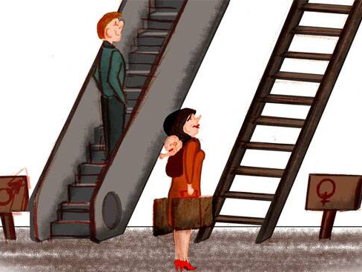
Setting the scene

Slide 24
Economic Empowerment of Women in Green Industry (EEWiGI) in 4 countries, 3 continents
Senegal
Cambodia
Peru
South Africa
Notes:
Diagnostics, assessments and policy analyses undertaken for enabling evidence-based policy making was done in four country sites: Peru, Senegal, South Africa and Cambodia. Research activities in each country were carried out between January – March, 2020.
(Map is sourced from UNIDO produced PowerPoint UNIDO_DCED EEWIGI_Final 121119)

Slide 25
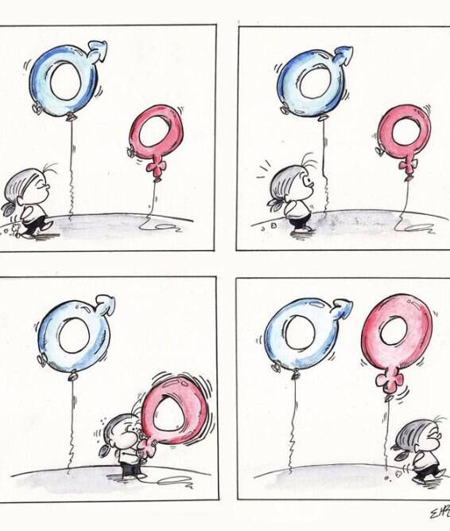
Results of the policy analysis

Slide 26
There is room to enhance measures to address gender equality and the empowerment of women
most of the policies reviewed in the four countries fail to include concrete gender equality measures;
a few reference “women” or “gender” in their conclusions; and
although many of the policies have good implementation plans, there is scope to become more gender-responsive.

Slide 27
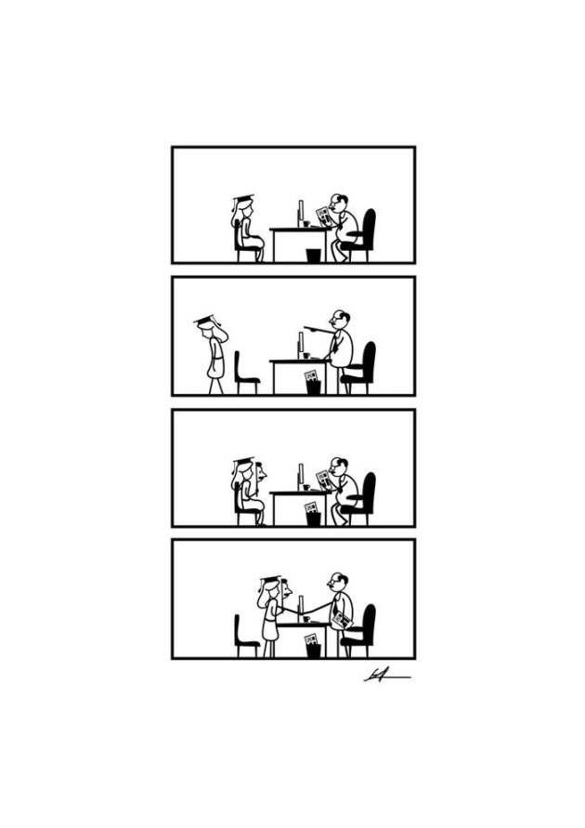
Conclusions from the quantitative & qualitative data

Slide 28
Findings
Limited evidence of EEW and participation in the green industry
Gender inequality is present in green entrepreneurship
Women overrepresented in less secure jobs
Subject to a multitude of discrimination (direct, indirect, institutionalized and structural)

Slide 29
“I often miss out on networking opportunities, especially at night, because I am not invited to go out 'with the boys' after work or because I have to go home with my children. And that's where business relationships are consolidated ”.
Participant of the focus group, Arequipa, Peru

Slide 30
Closing gaps between policy & implementation on the ground
Countries that reported the gaps |  | Key gaps between policy and implementation on the ground | Closing gaps between policy and implementation on the ground
Cambodia, Peru, Senegal, South Africa | Lack of clarity on green industry business and gender | green industry has not been defined; green industry, gender mainstreaming, women’s economic empowerment are new concepts to most people. lack of understanding about how the green concept fits in existing industry policy (e.g. SME policy); lack of public awareness about green industry; no policy/evidence to show how green growth will impact women entrepreneurs; | better understanding of green industry business is needed e.g. incentives available for women to enter green business; public awareness raising about green industry through; training/campaign/TVET/information sharing, primarily focusing on small scale women entrepreneurs; providing information sessions in order to introduce the concept of “green industry.”
Peru, Senegal, South Africa | Few programmes targeting women | although these types of programmes are often more effective than “gender-neutral” programmes. juxtaposition of customary law with formal legislation (specifically with regards to land rights for women). | generate more awareness about the benefits of gender equality and women´s inclusion; improve the knowledge and capacities of policymakers in terms of gender mainstreaming.

Slide 31
Closing gaps between policy & implementation on the ground
Countries that reported the gaps |  | Key gaps between policy and implementation on the ground | Closing gaps between policy and implementation on the ground
Cambodia, Peru, Senegal, South Africa | Gap in implementation | policies are there on paper, but the implementation is limited; law projects are often approved but take too long to become laws and even longer to be translated into specific plans; laws often lack specific guidelines; | As well as developing new policies, existing policies should be implemented more effectively. Need for cooperation across different government ministries to ensure relevant green industry initiatives are consistently gender mainstreamed; Local government institutions (for instance municipalities) responsible for executing “green” laws should be trained; successful women entrepreneurs in green industry should be encouraged to be ambassadors/role models sharing their experience to create snowball effects; barriers and challenges to women entrepreneurs at all levels should be identified e.g. from entrepreneurs (big, medium and small) to professionals; ease the process of business registration (irrespective of big/small scale business OR man/woman); involvement of men in gender mainstreaming

Slide 32
Closing gaps between policy & implementation on the ground
Countries that reported the gaps |  | Key gaps between policy and implementation on the ground | Closing gaps between policy and implementation on the ground
Cambodia | Lack of monitoring system | for example, in Cambodia, the Ministry of Women’s Affairs (MoWA) does not have any monitoring mechanism to see whether the policies are really benefitting the entrepreneurs. | need for nationally representative data and research to show how green growth will impact women entrepreneurs; Need for a monitoring mechanism to ensure gender representativeness in design, methodology and structurally is also needed;
Cambodia, Senegal | Budget constraints | government has budget constraints in full implementation of the policies. | policies to be divided into short-term and long-term goals execution to be done step-by-step depending on funding availability

Slide 33
Positive attitude of women in the green industry
things have improved over the last 10 years (e.g. most female entrepreneurs are excited about the future);
several key indicators suggest a high potential for social transformation (e.g. more equal pay, greater support from families, less need to "consult a man");
less gender bias and more supportive men;
newer jobs are less affected by traditional gender stereotypes;
the green industry naturally adapts to the 'care role' of women.

Slide 34
“As women, we naturally become mothers and as mothers, it is important we take care of our children and we do this by engaging in the green industry.”
CEO, Recycling and Waste Management Company,
KII, Dakar, Senegal

Slide 35
When you decided to start your business, where did you find seed/start-up capital (%)?
 | Cambodia | Peru | Senegal | South Africa
My personal savings | 69 | 62 | 13 | 78
Credit from formal institution (e.g., bank) | 23 | 12 | 0 | 17
Informal credit from my family, friends or creditors | 15 | 15 | 25 | 17
Other | 23 | 12 | 50 | 22

Slide 36
When starting your business, where did you acquire the technical knowledge/managerial skills?
 | Cambodia |  | Peru |  |  |  | South Africa
 | Technical knowledge | Managerial skills | Technical knowledge | Managerial skills | Technical knowledge | Managerial skills | Technical knowledge | Managerial skills
Self-taught | 62 | 69 | 46 | 62 | 50 | 38 | 78 | 65
Formal training at an education institution | 31 | 31 | 46 | 31 | 50 | 25 | 57 | 52
Personal mentor | 31 | 15 | 8 | 12 | 25 | 25 | 35 | 22
Internet resources | 38 | 31 | 23 | 19 | 13 | 13 | 48 | 17
Other | 23 | 23 | 19 | 12 | 13 | 0 | 13 | 17

Slide 37
How excited or apprehensive do you feel that your “green” business will grow (%)?

Slide 38
“In green industries you need collaboration more than competition, empathy more than individualism, and a long-term focus on the common good rather than a short-term attention to profitability. Women are better in all those things.”
Director of Peripheria , KIII, Lima, Peru

Slide 39
COVID-19 is exposing vulnerabilities in social, political and economic systems that were always present
women are disproportionately affected;
Earn less, more precarious jobs, informal sector
great impact on women in all value chains;
accentuated by an unequal division of care and household responsibilities;
force a change in priorities and funding in the public and private sectors;
jeopardize progress made so far towards gender equality and empowerment
unique opportunity to bring transformative changes;
the need to prioritize women and economic recovery along more equitable lines;
women are key agents of post-crisis recovery;
the green industry is new, innovative and part of a growing market.

Slide 40
Orkun
Gracias
Merci
Dankie

