Slide 1
ITPO Seoul, Korea
GLOBAL CALL is UNIDO’s annual event to award companies with innovative solutions to global challenges
UNIDO ITPO Korea will host the Global Call 2024 under the theme ‘FoodTech Innovation and ISID’ on Nov 21st in Seoul. It will show the advancement of of FoodTech in developing countries and its potential to address challenges within food systems
Applications and Winning Companies
Other developing countries
Africa
Africa
228 applications from 55 countries
(77applications from African countries)
UNIDO Director General’s awards – 18 companies
(8 companies from developing / 5 from Africa)
Out of the 18 companies, 4 are participating in WWHC, with 3 of them from African countries

Slide 2
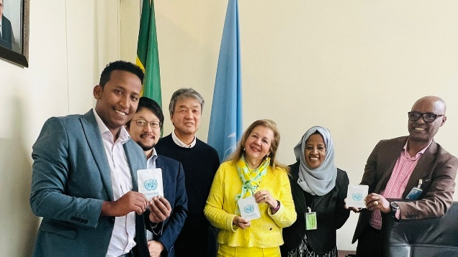
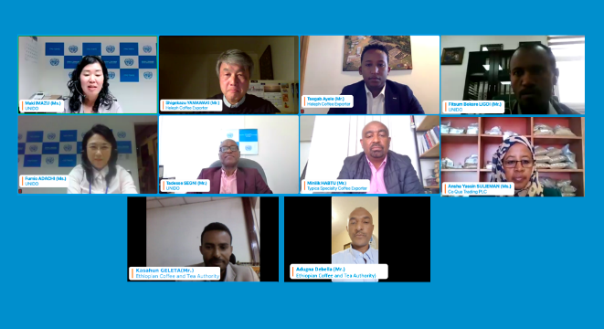
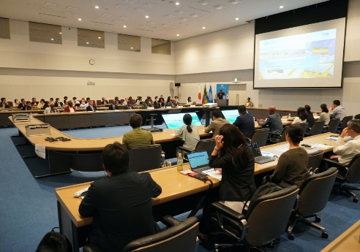
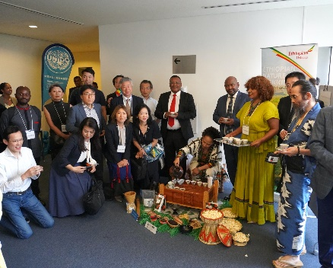
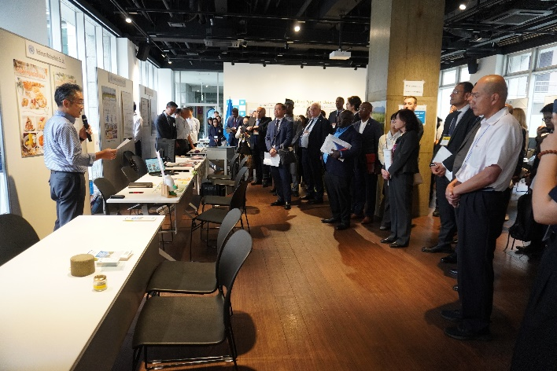
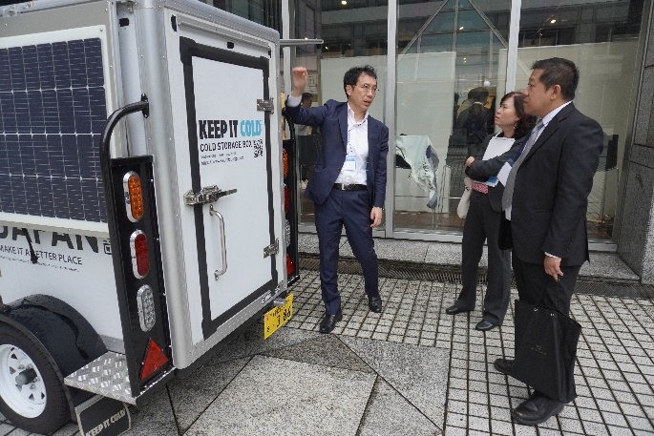
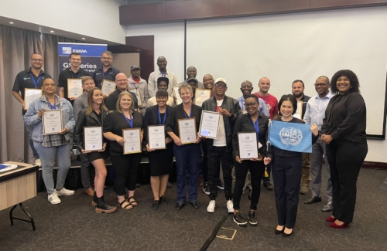
ITPO Tokyo, Japan
Investment Promotion
Technology Promotion
Delegate Programme
– Agro-Industry, Smart Agri, High nutrient foods
Africa Advisors Programme
- Coffee webinar, Coffee value addition
STePP
149 Japanese Technologies
- 45 Agribusiness
STePP promotion in Sept. 2024
95 participants from Embassies and Int’l organizations
- Rice husking and milling/cold chain Tech.
STePP Industrial Vocational Training (IVT) – Suction pump tech.

Slide 3
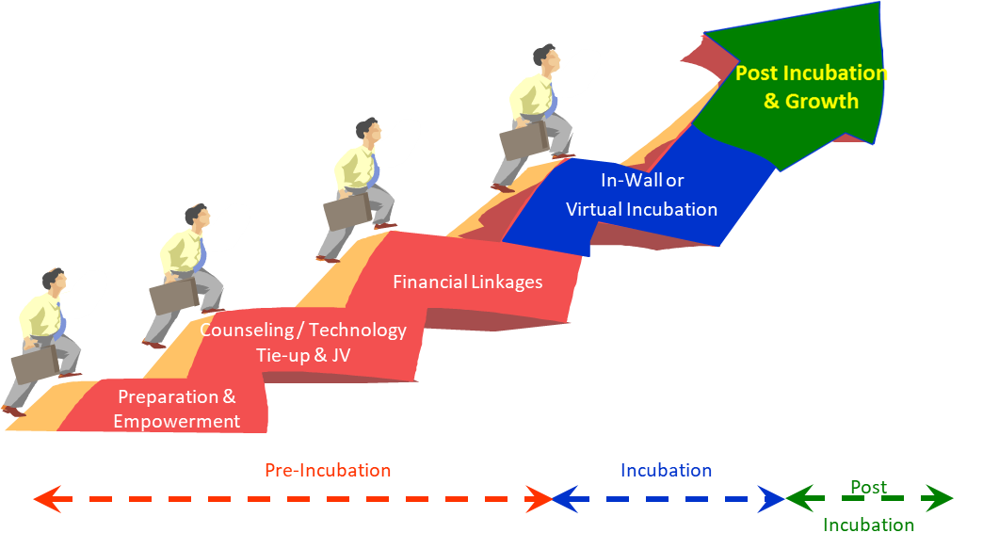
ITPO Manama, Bahrain
Agro-preneurs – Enterprise Development and Investment Promotion Program / EDIP
Notes:
ITPO's best practices in bridging technology and investment for a World Without Hunger

Slide 4
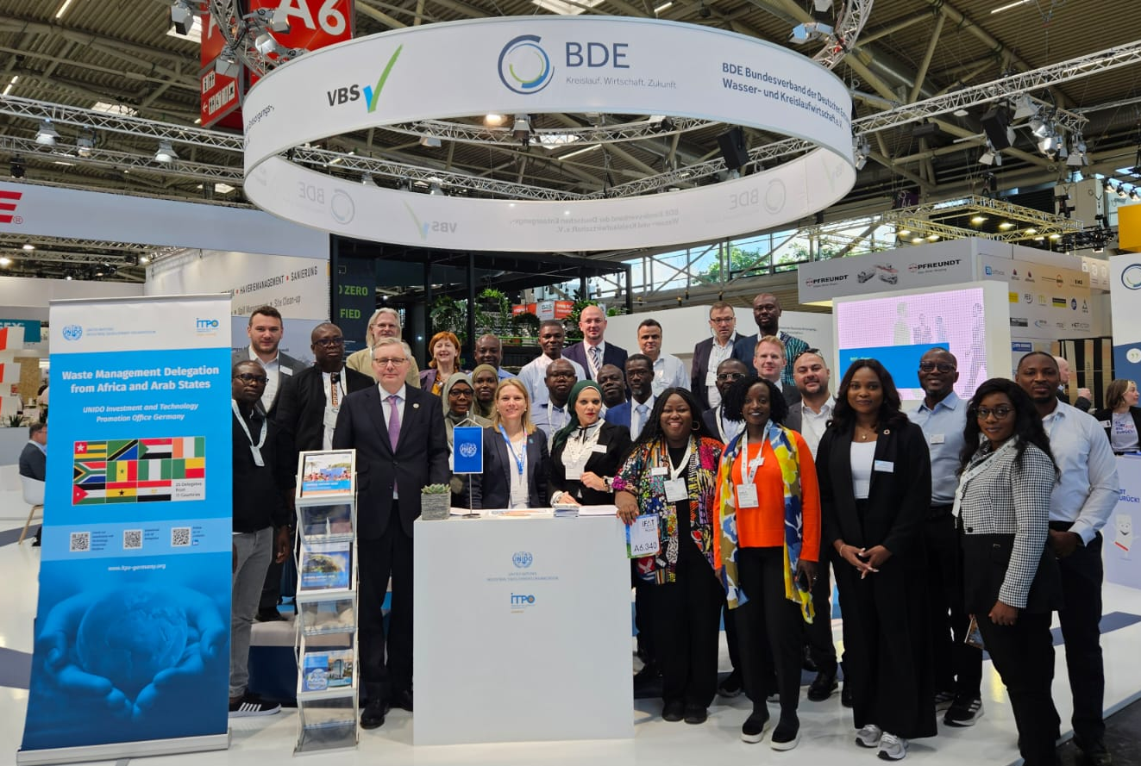
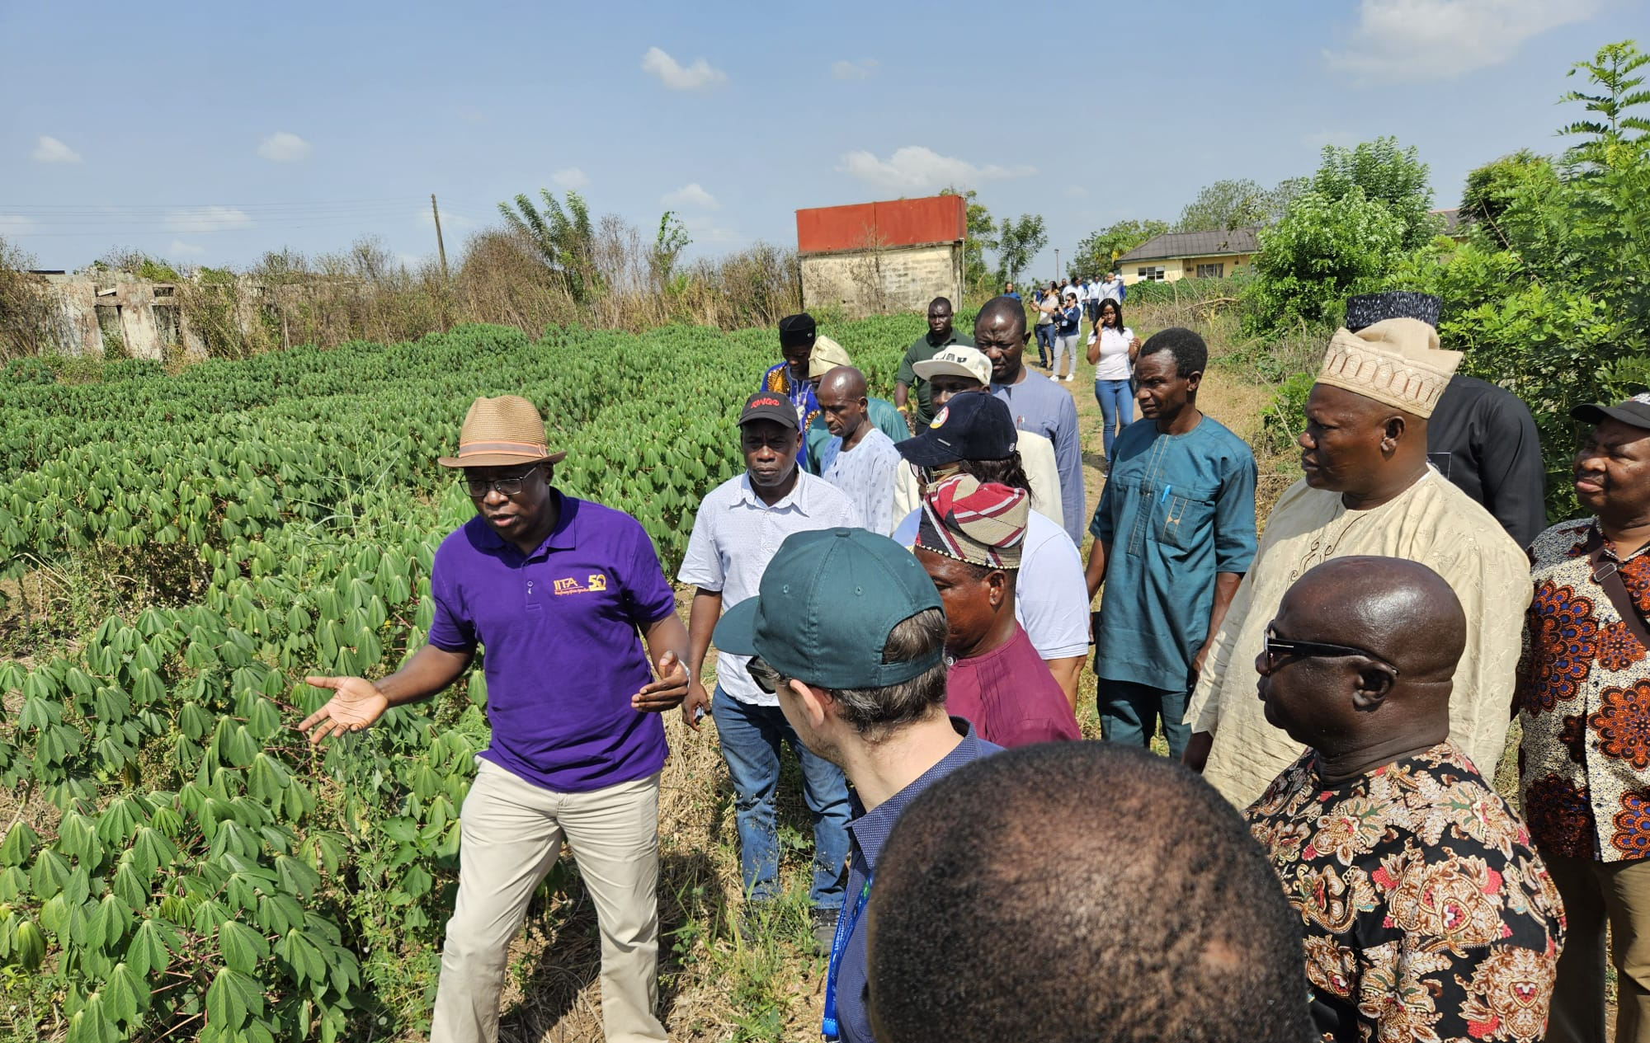
ITPO Germany, Bonn Office
Ending hunger by promoting sustainable technologies and investments in agribusiness
Delegate Programmes on...
Poultry and Biogas to Eurotier / World Poultry Show, Hanover with participants from 8 countries
Environmental Technologies for Emerging Markets to IFAT, Munich with participants from 11 countries
Modern Industrial Baking Technology to IBA, Munich with participants from 11 countries
Private Sector Missions focusing on…
Agri-Value Chain Investment in Somalia with 7 companies
Food Processing in Togo & Benin with 11 companies
Food Processing in Nigeria with 10 companies
Sustainable Palm Oil in Nigeria with 8 companies

Slide 5
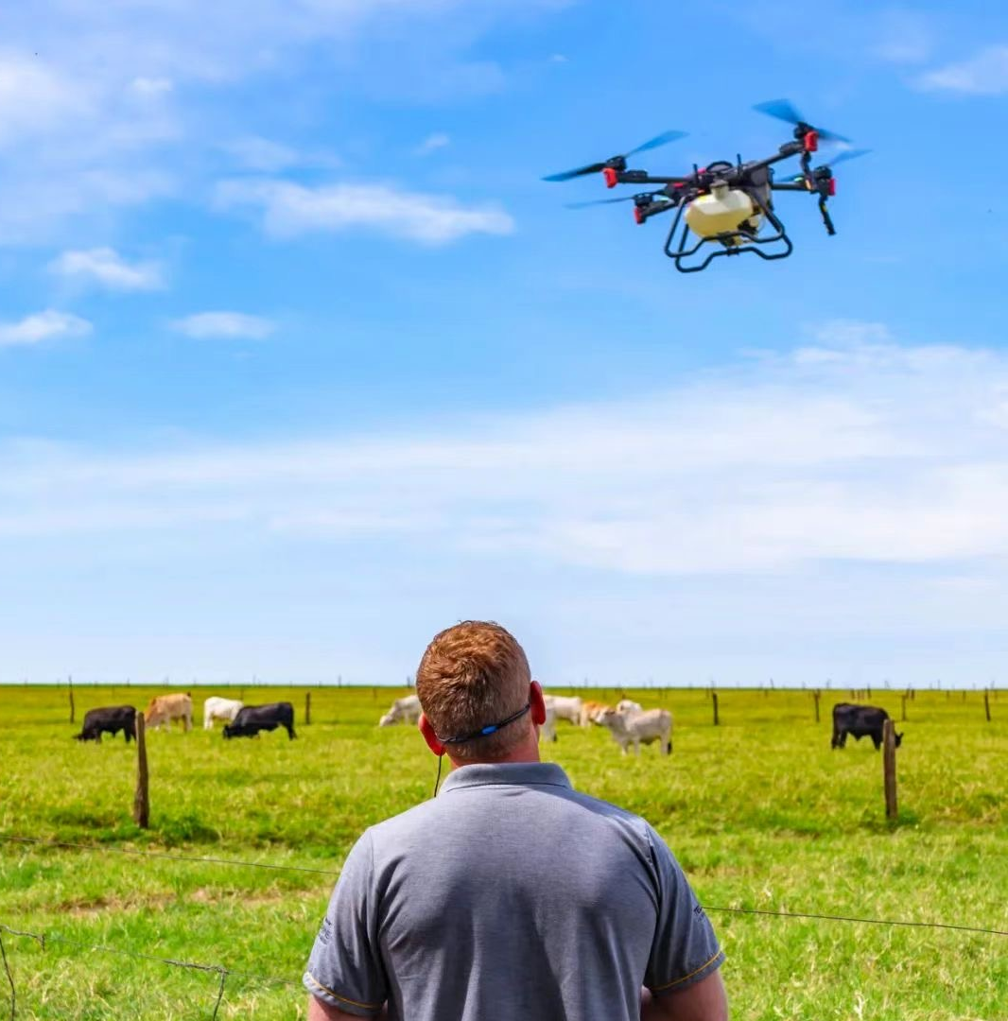
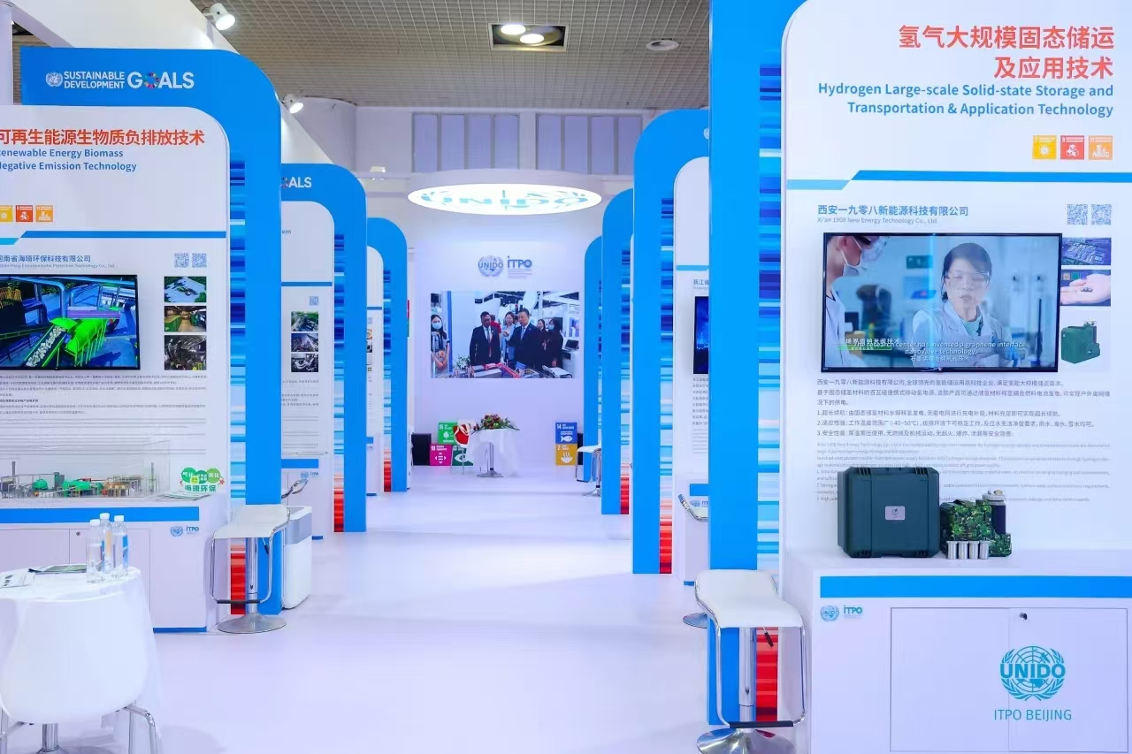
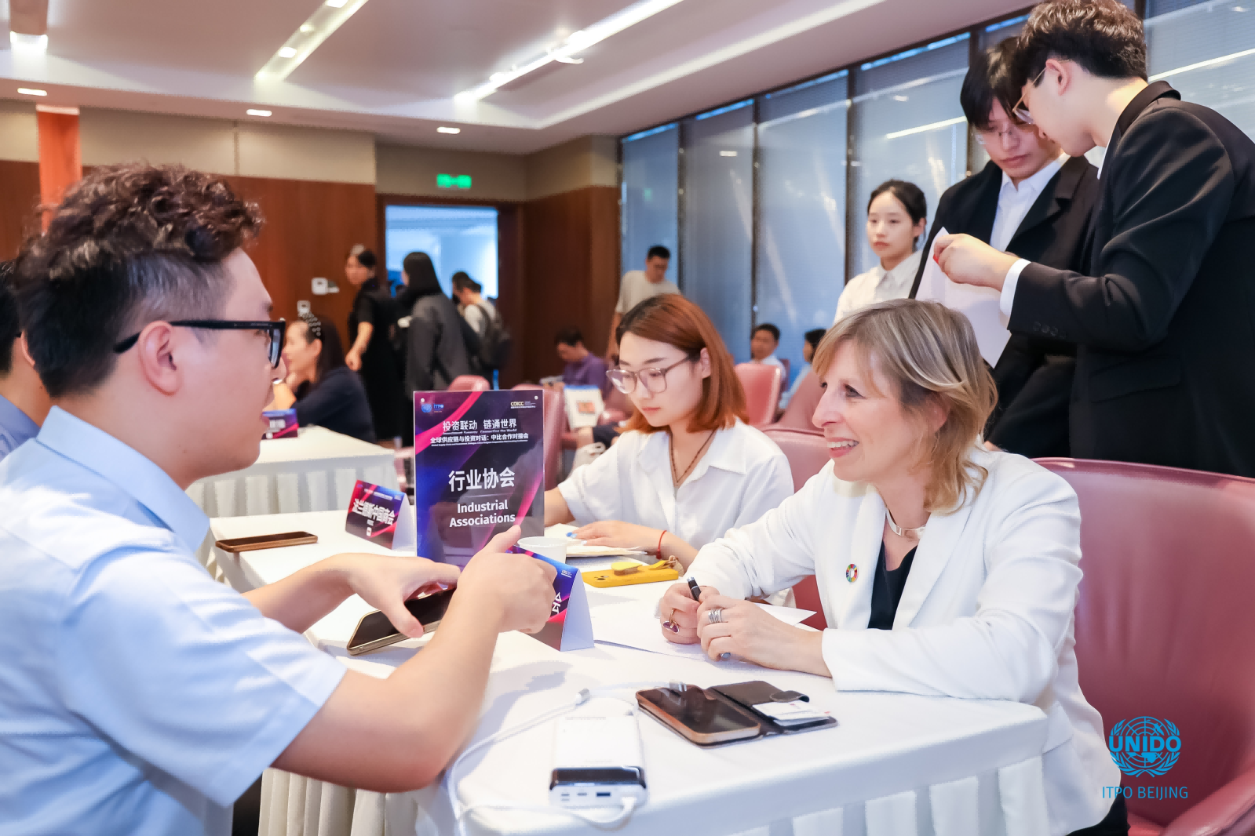
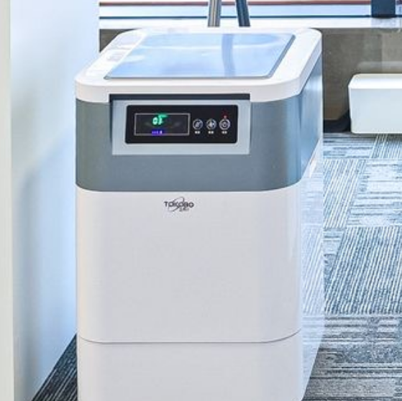
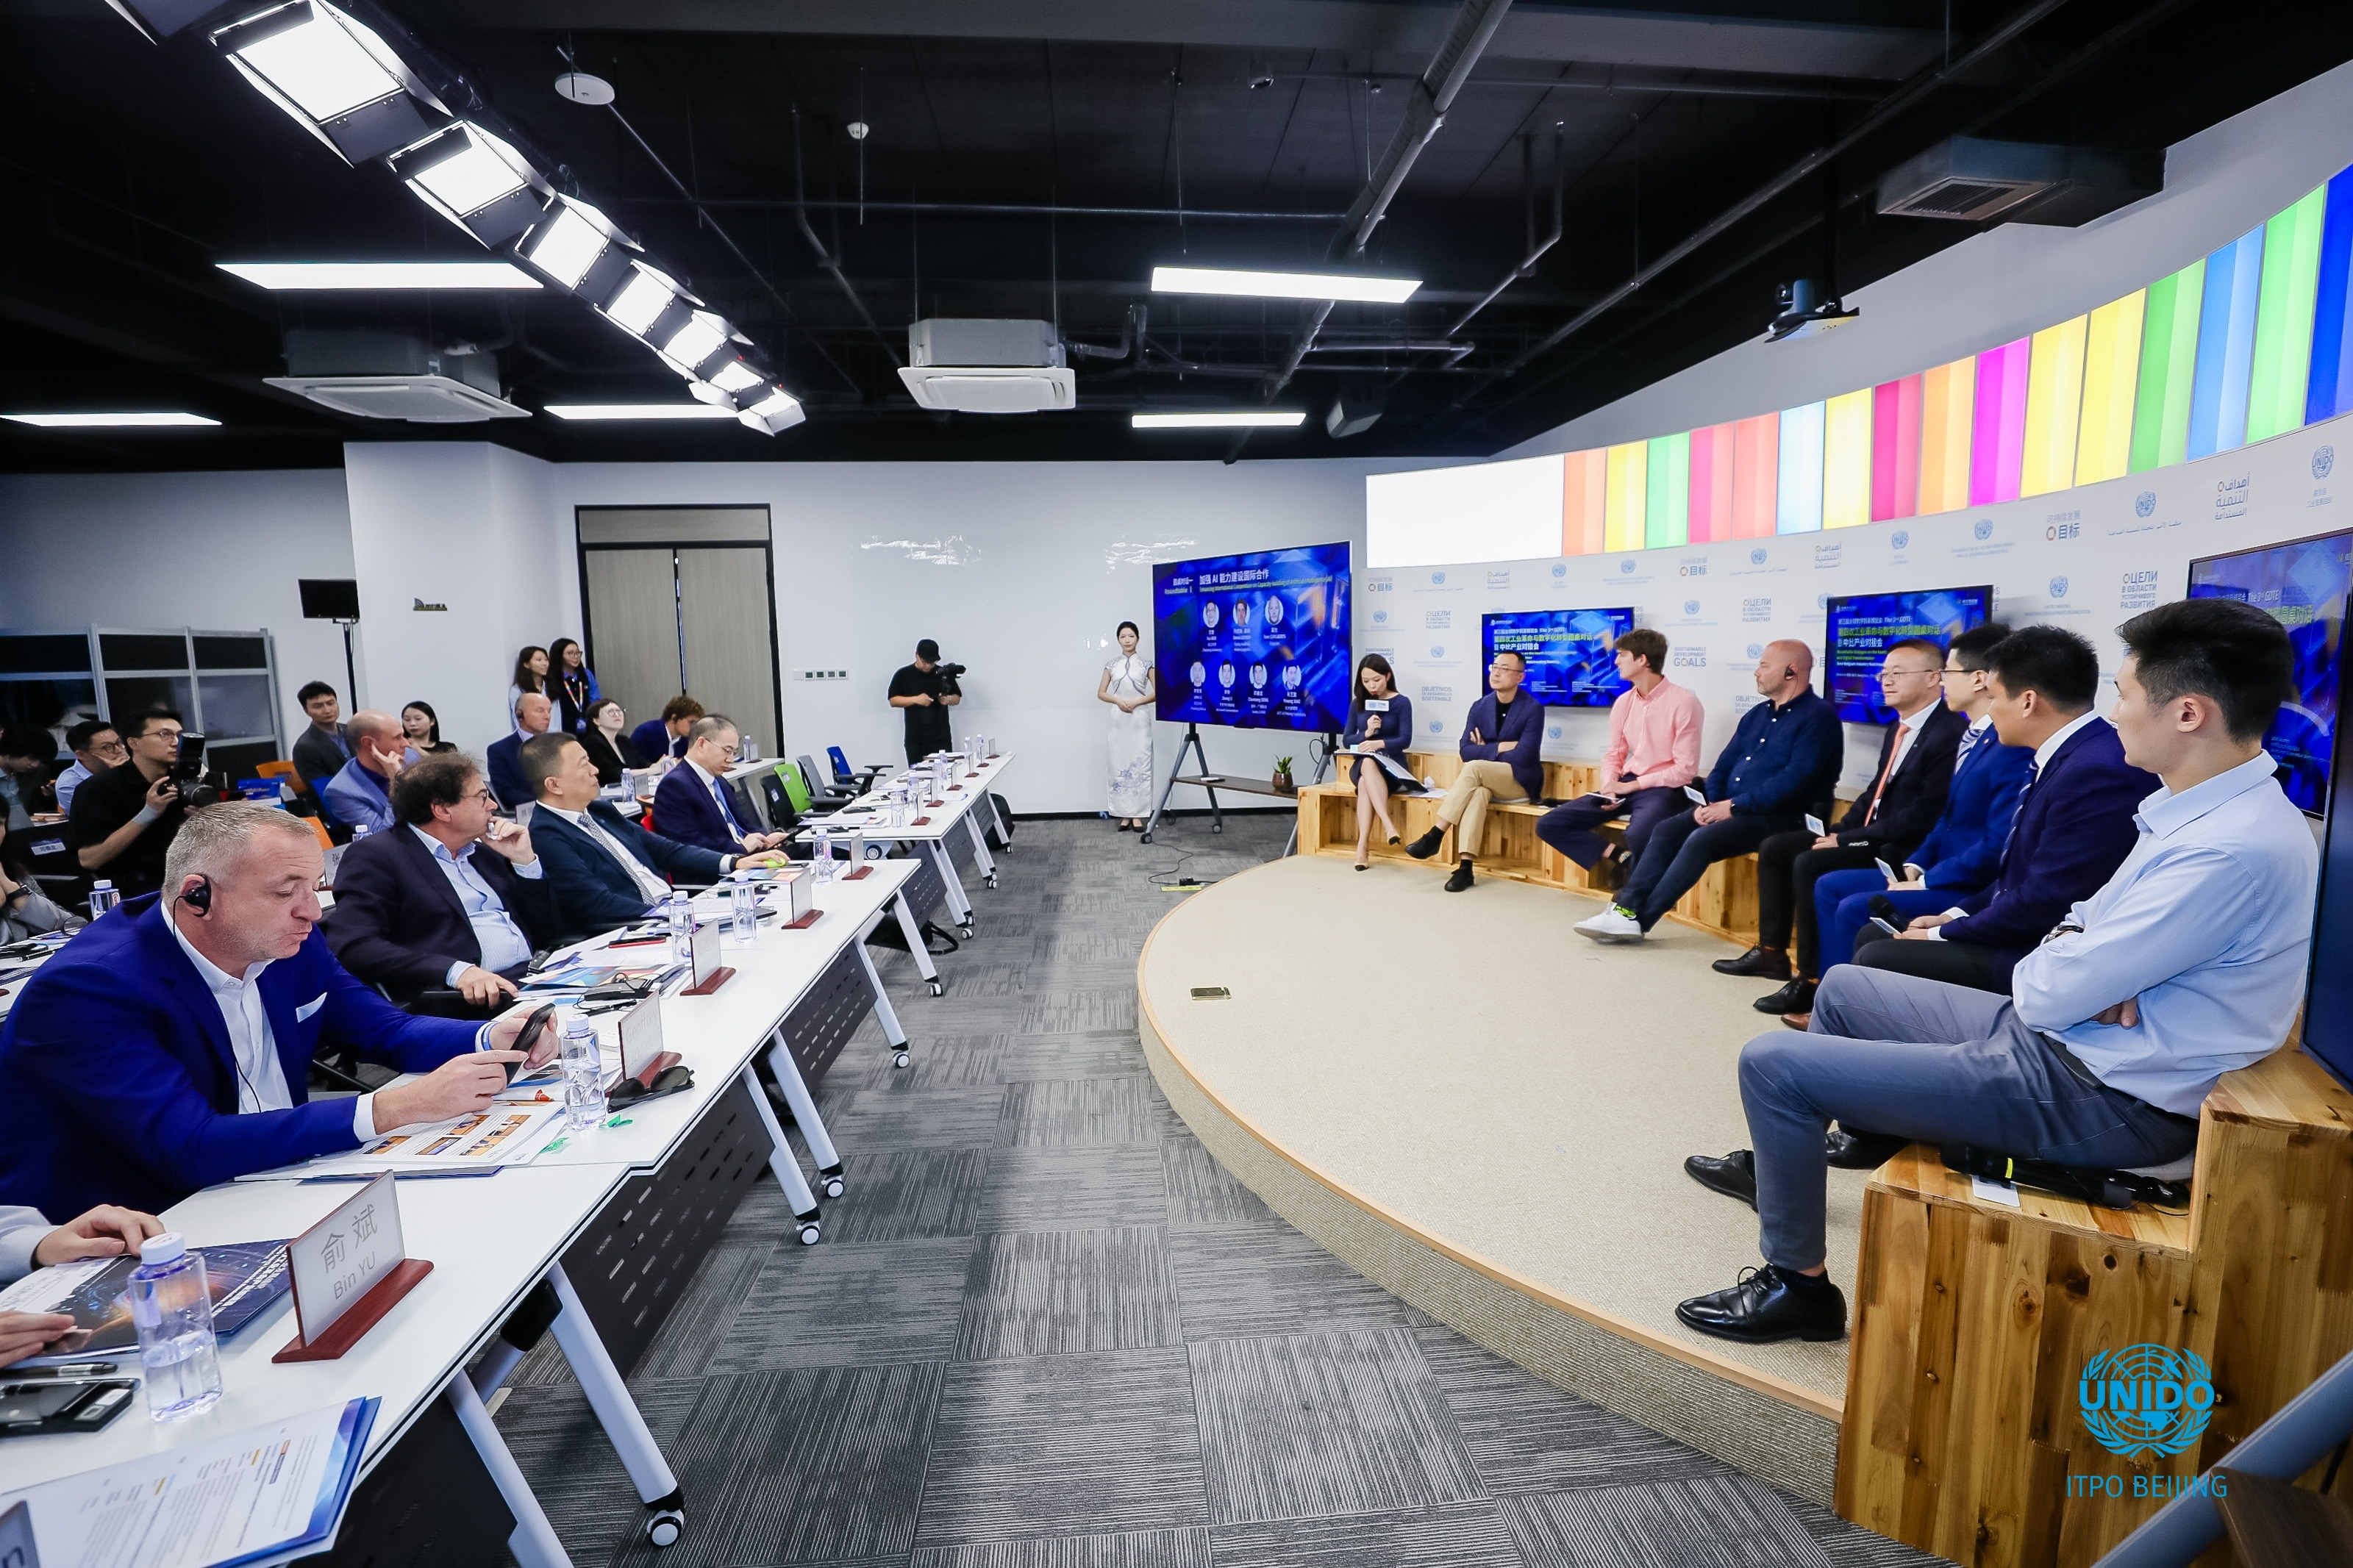
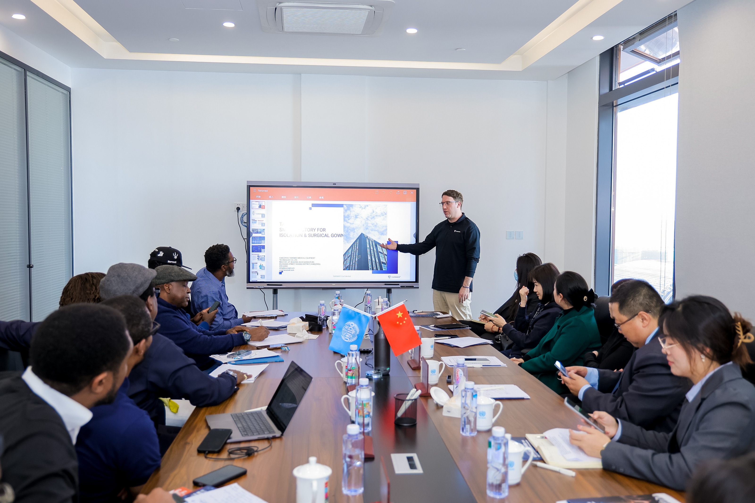
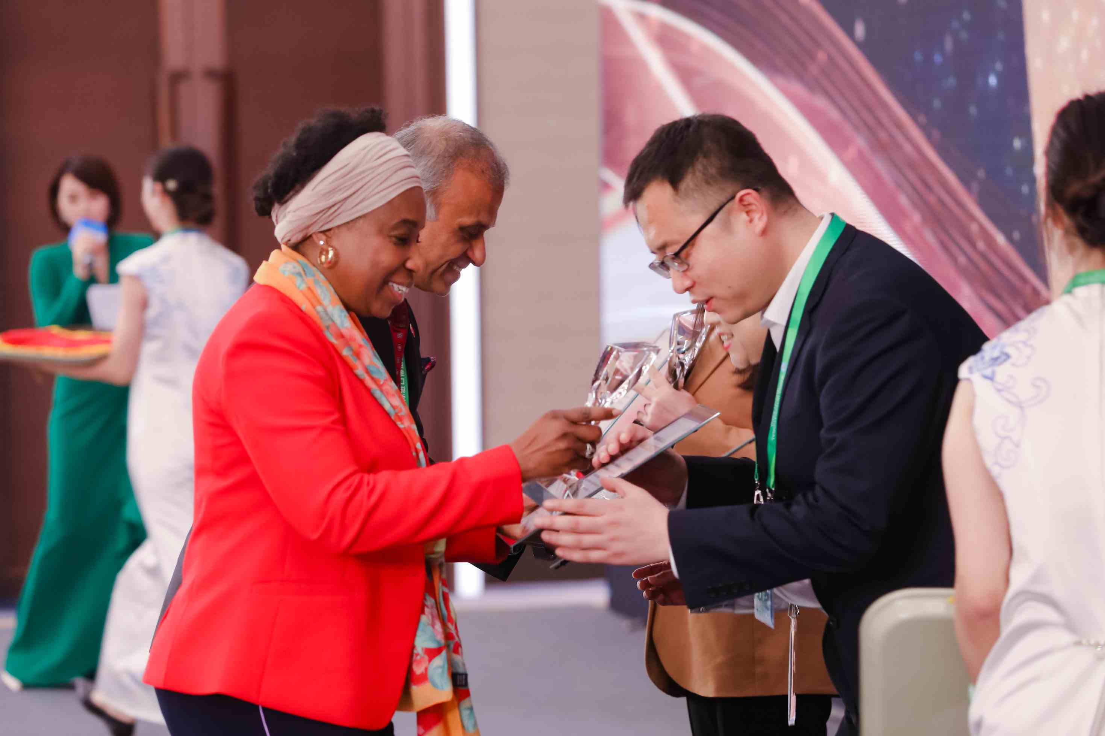
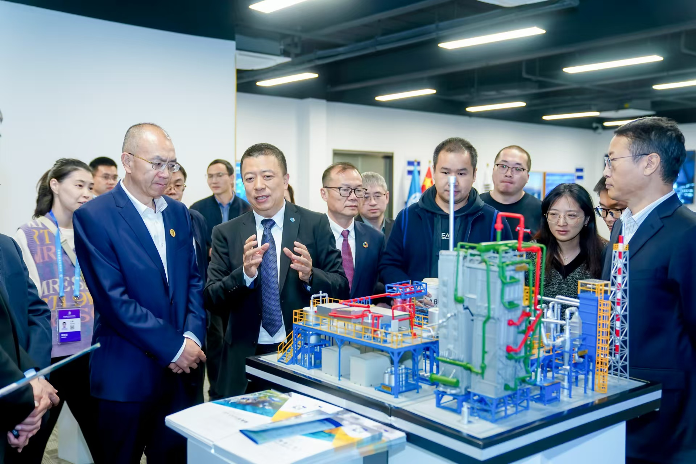
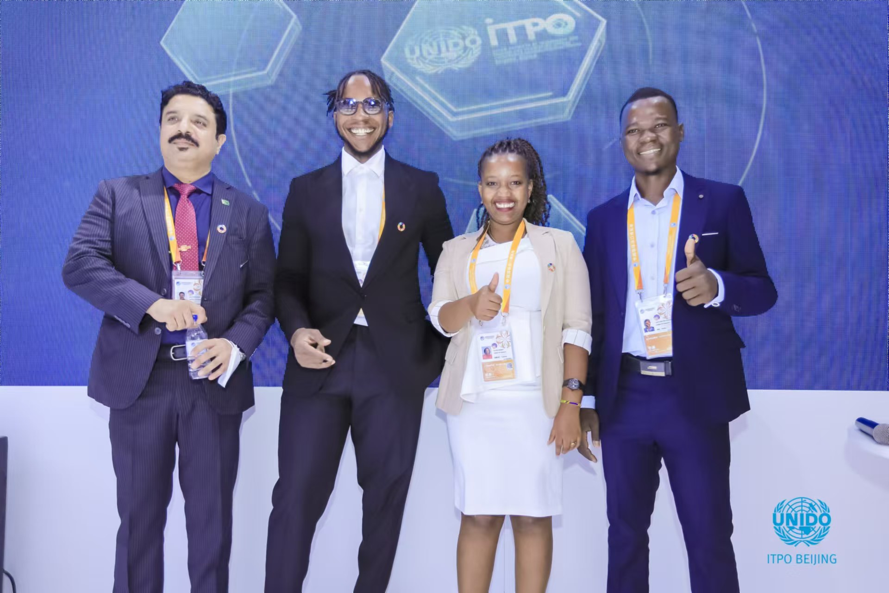
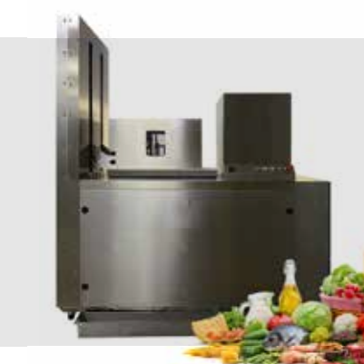
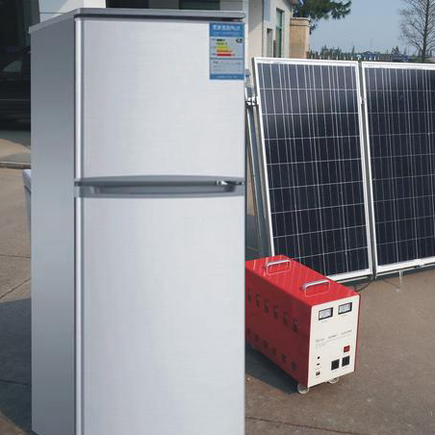
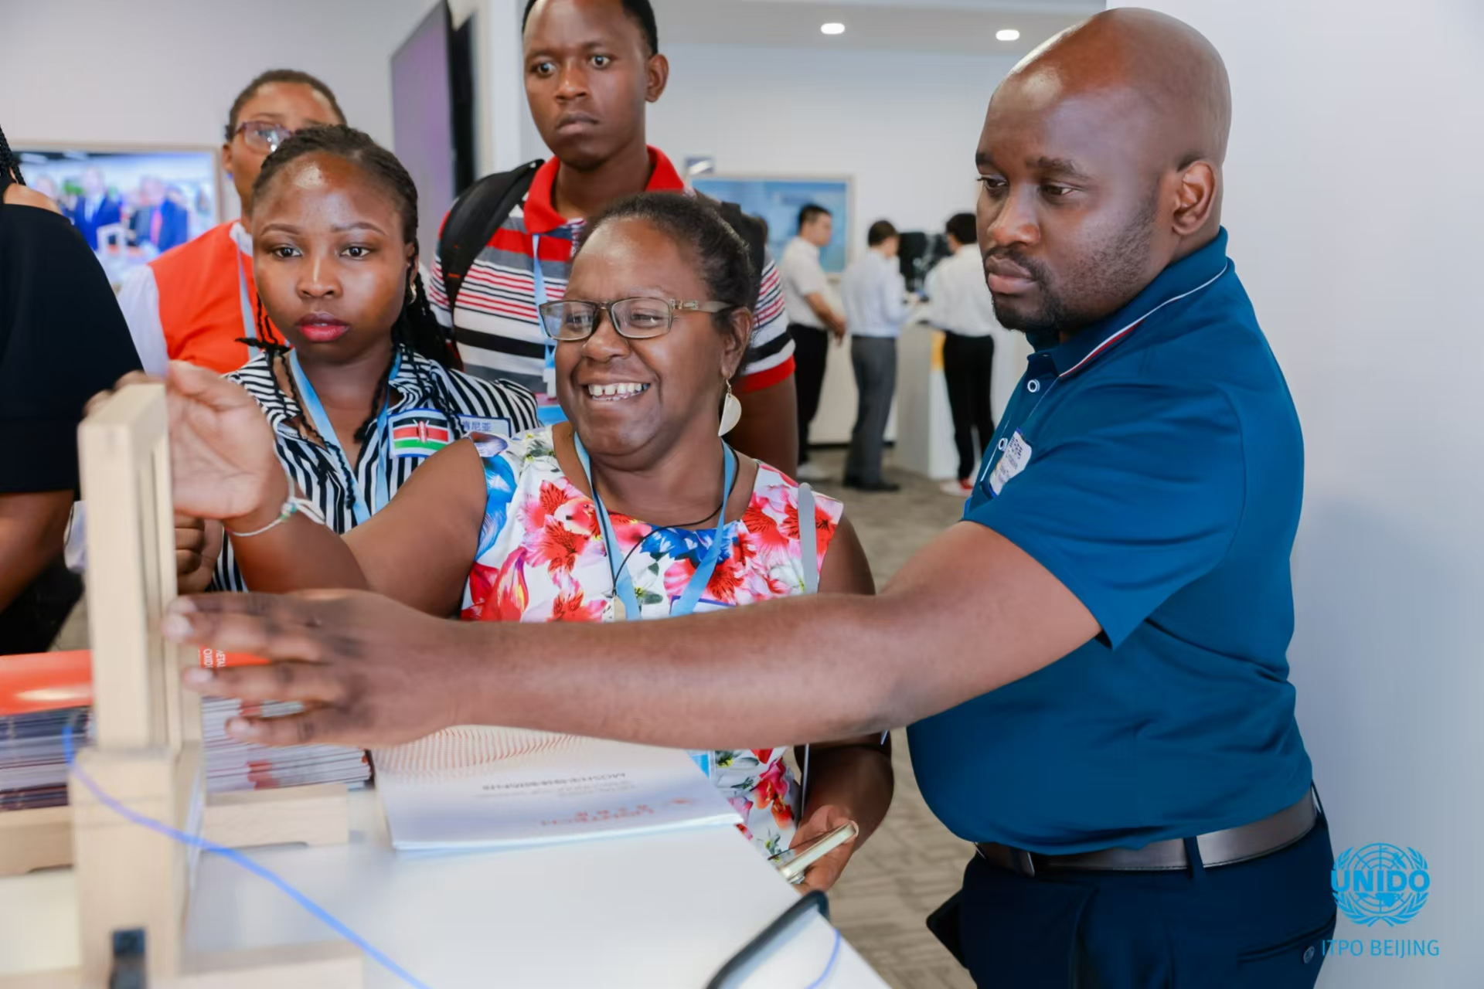
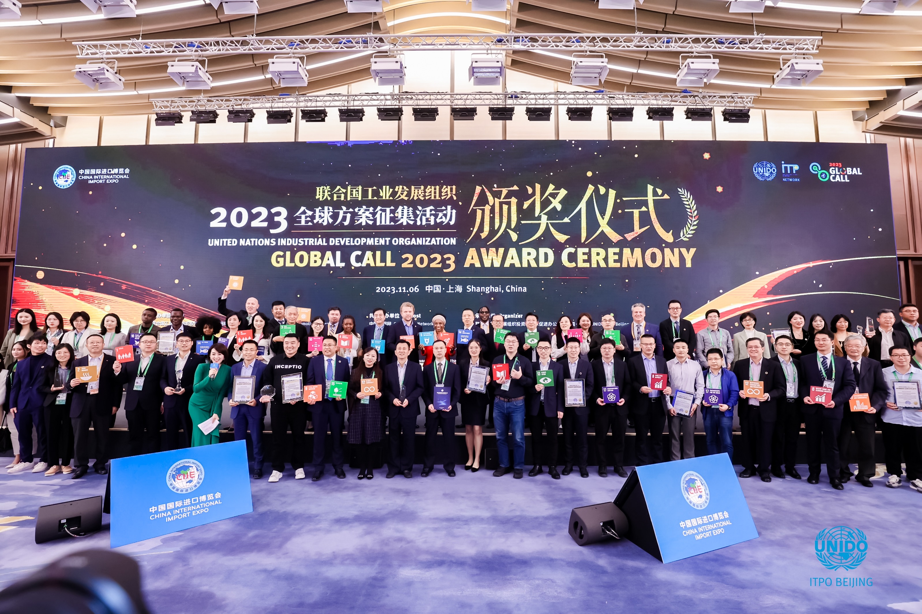
ITPO Beijing, China
Smart
Agriculture
Discover
Identify
Evaluate
Implement
Competition
Accelerator
Technological
Viability
Accessibility
Affordability
Full
Value
Chain
--From Farm
to Fork
Food Waste
Processing
Artificial
Water Source
Exhibition
Matchmaking
Market Feasibility
Overseas Delegation
High-Speed
Freezing
Solar DC Refrigerator and Cooker

Slide 6
ITPO Moscow, Russia
Cooperation with the world leading producers of fertilizers and development of joint initiatives (PhosAgro, Uterra);
Development of the joint projects designed to promote innovative technologies, strengthen food security and increase agricultural productivity;
Support of the state programmes focused on desertification control;
Organization and participation in the national and international forums, conferences to promote ITPO’s tools, methodologies, best practices, and policy solutions to support the 2030 Agenda for Sustainable Development (no poverty, zero hunger, climate action).
Notes:
ITPO's best practices in bridging technology and investment for a World Without Hunger

Slide 7
ITPO Lagos, Nigeria
01: A ₦1.78 billion investment in 198 tech-enabled greenhouses across three Nigerian states, targeting the ₦185 billion combined vegetable market, promising 390 direct jobs.
02: Advancement of SATS-C Policy
ITPO Nigeria supported the advancement of the SATS-C policy to address Nigeria's $12 billion post-harvest losses.
03: Investment and Technology Promotion of Non-oil sectors
ITPO Nigeria promoted the development of micro, MSME cluster development and industrial parks.
04: Partnership with UNIDO NQIP
Collaborated with UNIDO NQIP to organize the Food Safety and Investment Forum aimed at promoting inclusive and sustainable development.
05: Exposure to Italian Leather Cluster Model
ITPO Nigeria facilitated a study tour to Italy for participants to gain insights into the Italian leather sector’s best practices.
Notes:
01: A ₦1.78 billion investment in 198 tech-enabled greenhouses across three Nigerian states, targeting the ₦185 billion combined vegetable market, promising 390 direct jobs and break-even within 18-24 months through year-round hydroponic production.
02: ITPO Nigeria supported the advancement of the SATS-C policy by recommending its development to the Federal Ministry of Industry, Trade and Investment (FMITI) and strategically engaging the Special Adviser to the President on Trade and Investment to drive completion of the policy process and secure implementation approval - establishing a framework to address Nigeria's $12 billion post-harvest losses through integrated logistics, secure commodity zones, and digital corridors.
03: ITPO Nigeria promoted the development of micro, MSME cluster development and industrial parks: Key initiatives include: Shea butter initiative in Niger state, flagship leather programme in Sokoto state, stone sector development in Ogun State, and fashion hub programs in Lagos State
04: Collaborated with UNIDO NQIP to organize the Food Safety and Investment Forum aimed at promoting inclusive and sustainable development by identifying, attracting and mobilizing appropriate investment for MSMEs in Nigeria and the West African Sub-region.
05: ITPO Nigeria facilitated a study tour to Italy for participants to gain insights into the Italian leather sector’s best practices. Following the study tour, ITPO Nigeria supported ITPO Italy in its mission to Nigeria by organizing meeting with over 20 institutions, associations and local companies in tanning and leather production sector

Slide 8
ITPO Shanghai, China
Create A World Industrial & Innovative Technology Cooperation Platform
566⁺
30⁺
Technologies
& Solutions
How to Bridge Technology and Investment?
Countries
Real-World Scenarios
Application
Smart Agriculture
& Food
B2B business matchmaking
Green Growth
B2G
Global Fora
Fund
Matching
Advanced Digital
Production
Global
Partnership
Medicine & Health
Knowledge Sharing
Capacity Building

Slide 9
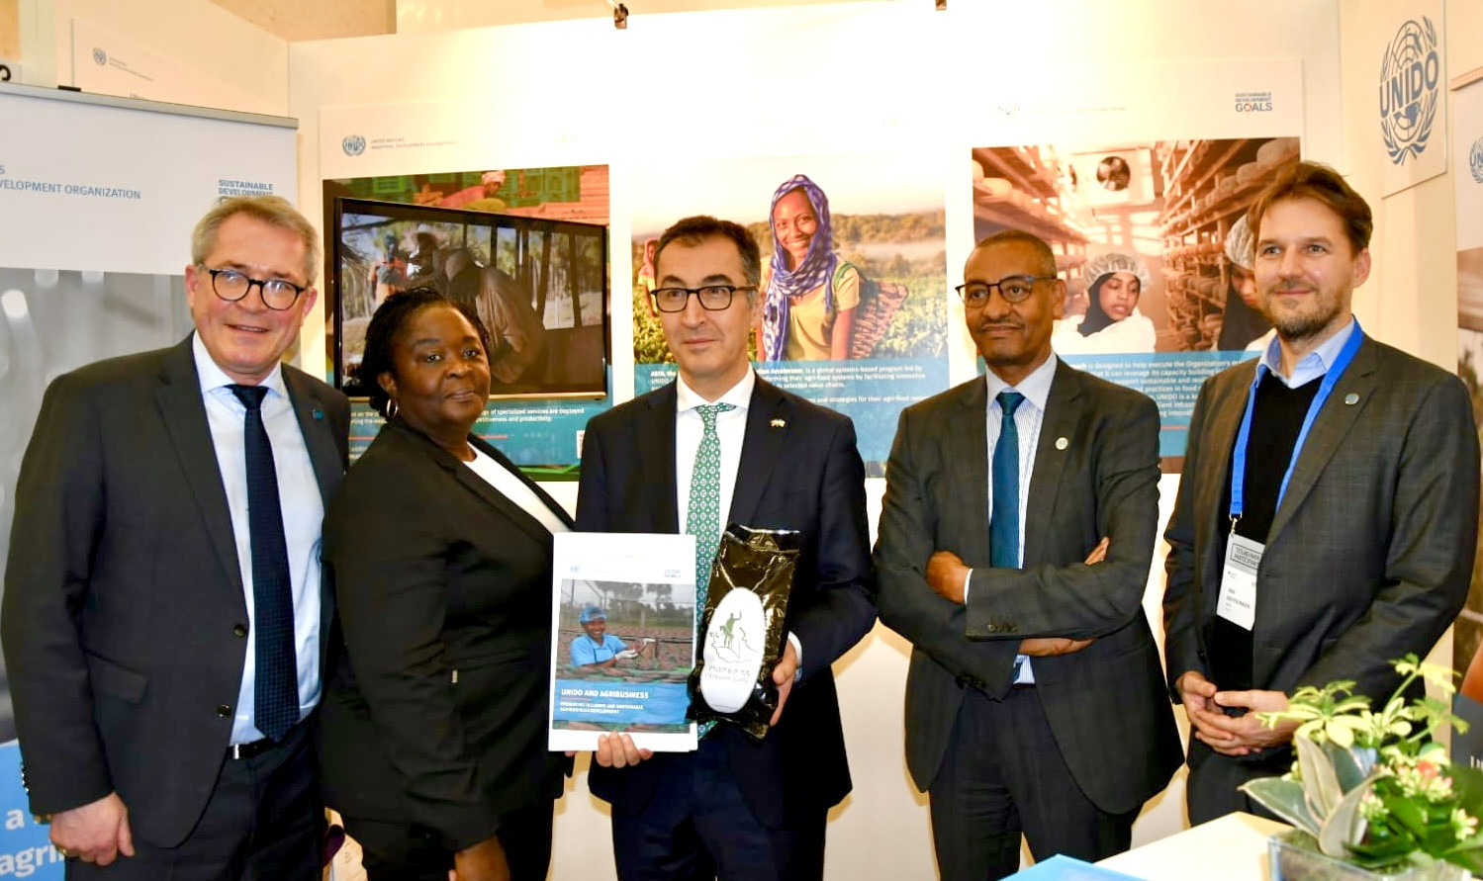
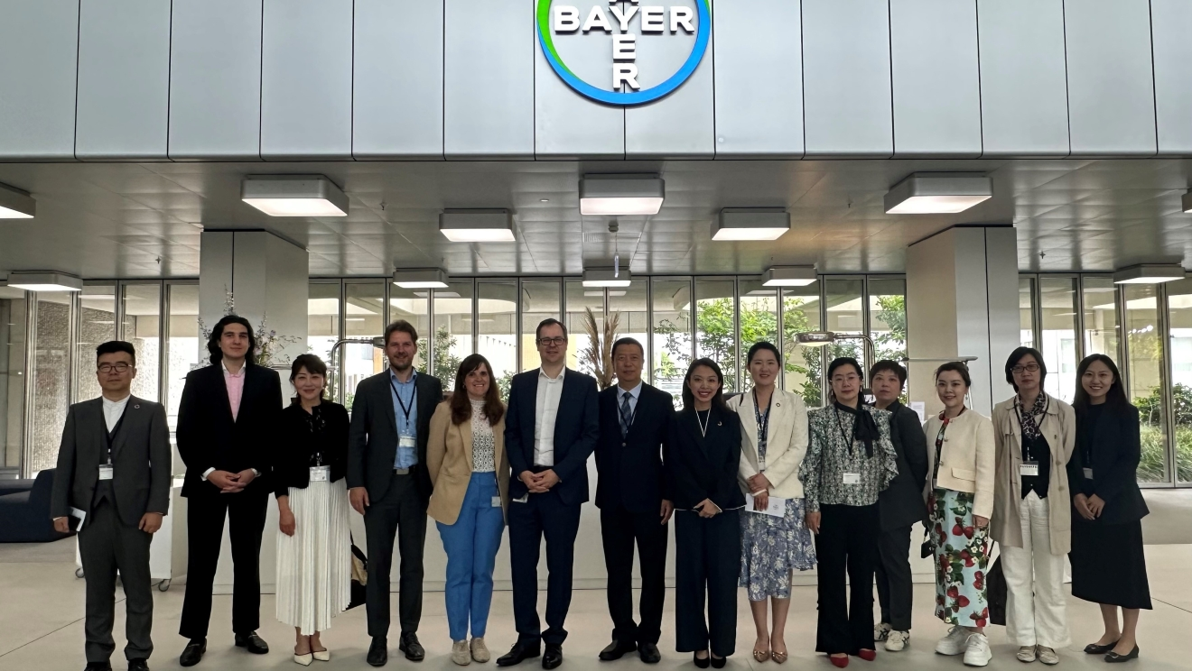
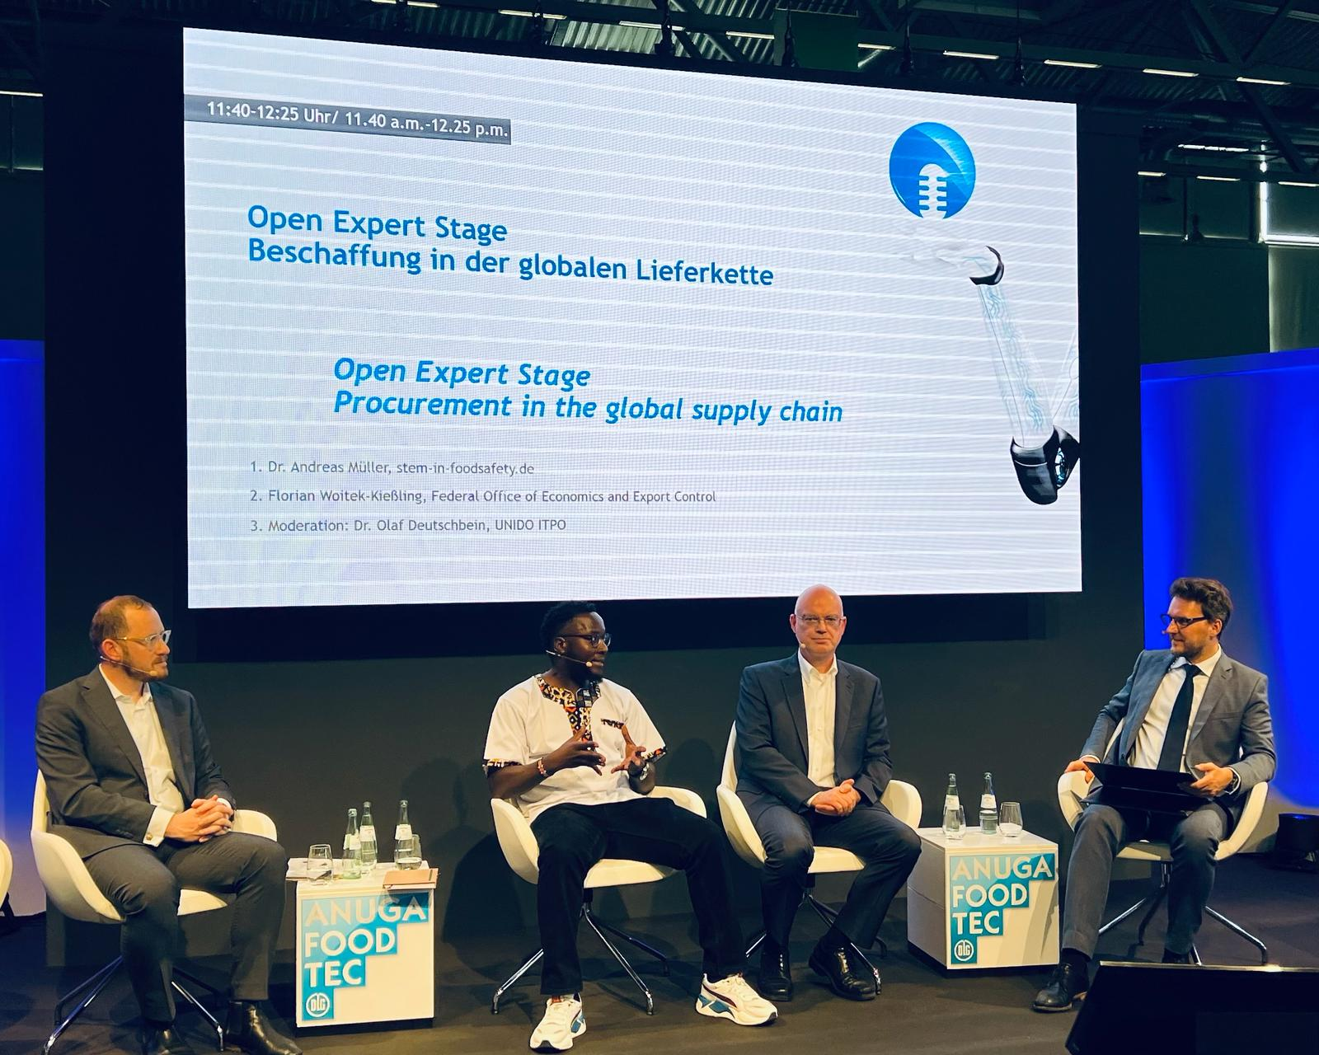
ITPO Germany, Berlin Office
Ending hunger by promoting sustainable technologies and investments in agribusiness
Strategic cooperation with governments, multinational companies and business associations in Germany
Close cooperation with the German Government, e.g. at world leading agricultural conferences (Green Week, GAAF).
Strategic partnerships with multinational companies, e.g. joint declaration with Bayer AG on sustainable agri-food systems in two pilot countries.
Strategic partnerships with business associations, e.g. joint declarations with GIZ and the German-African Business Association (AV) on agri food supply chains.
Cooperation with trade fairs e.g. ANUGA Foodtech (world’s leading trade fair for food & beverage industry) on local food processing.
Showcasing best practices with SDG Innovation Award.

Slide 10
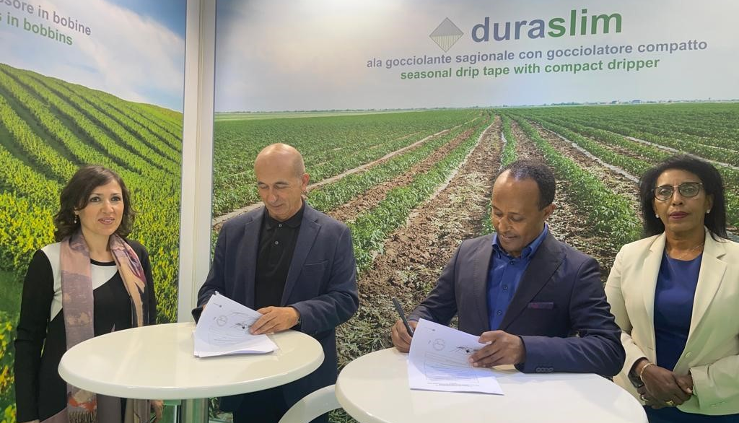
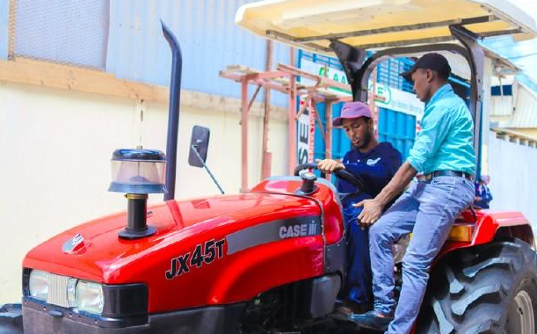
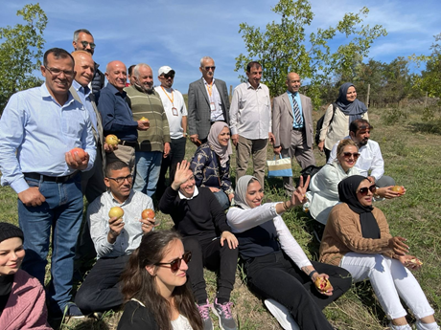
ITPO Rome, Italy
FACILITATING
INVESTMENT
SHOWCASING
NEW SOLUTIONS
BUILDING PARTNERSHIPS
FOSTERING TECH INNOVATION
Ethiopia - Innovative solutions for precision agriculture and an efficient use of water resources
Lebanon - Twinning partnership for winemakers in the Bekaa Valley
Somalia - Case IH Academy - high-skilled training programs for farmers and mechanics
Iraq - Sustainable agro-energy training for innovators from Basra with ENI

