Slide 1
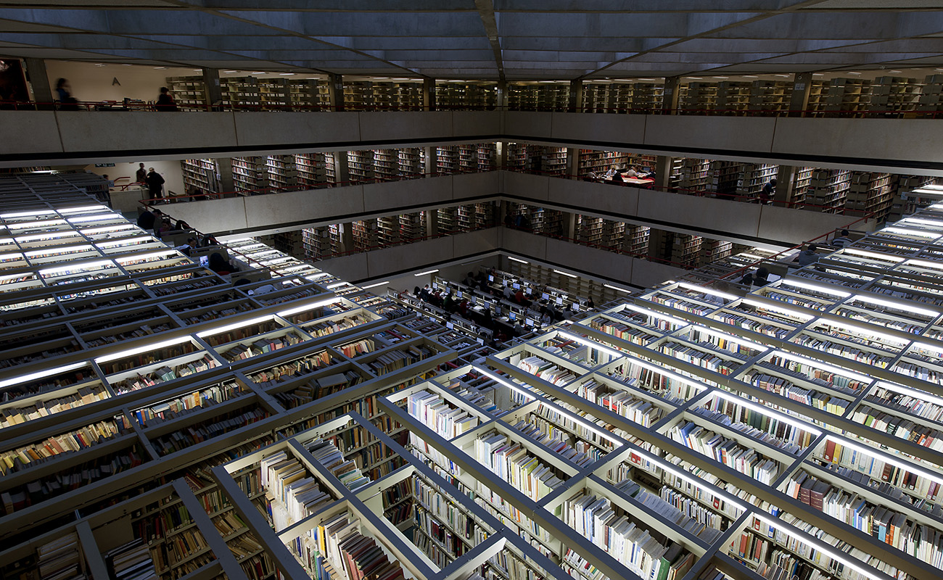
GREEN HYDROGEN FOR FOOD SECURITY IN AFRICA
Abraham Lartey

Slide 2
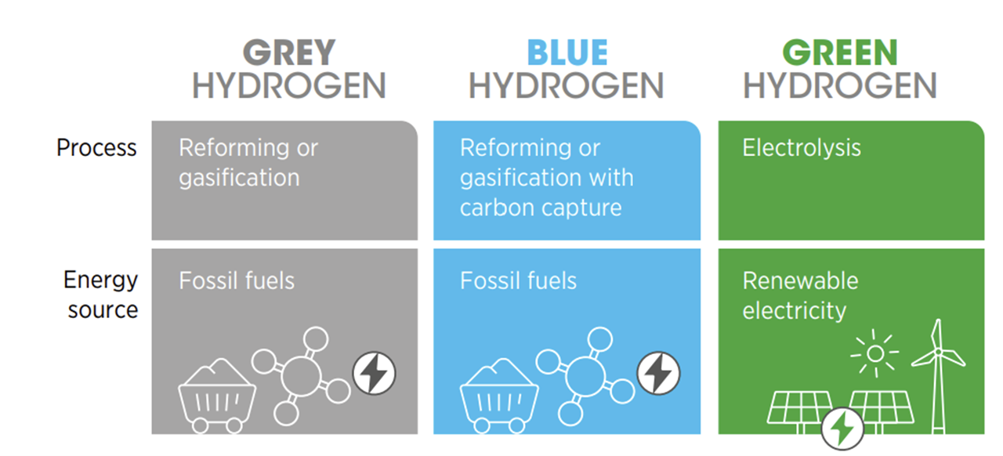
DIFFERENT SHADES OF HYDROGEN
SOURCE: IRENA, 2020

Slide 3
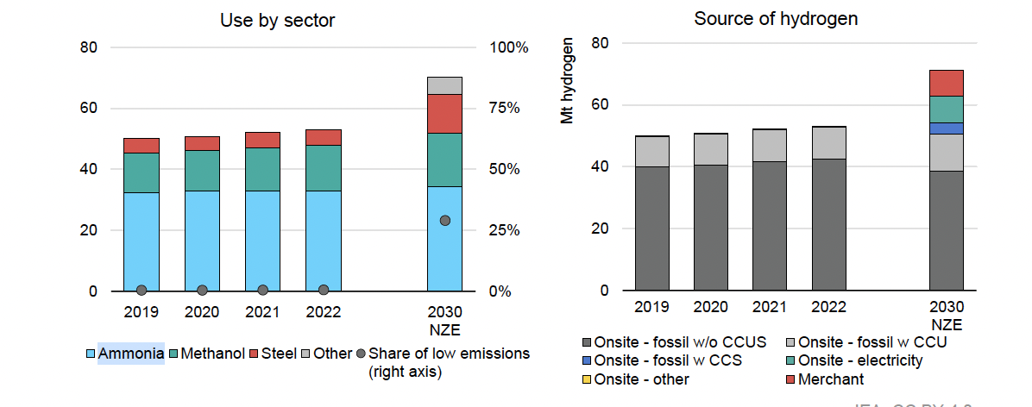
MOST OF THE INDUSTRIALLY PRODUCED HYDROGEN IS USED TO MAKE AMMONIA
SOURCE: IEA, 2022

Slide 4
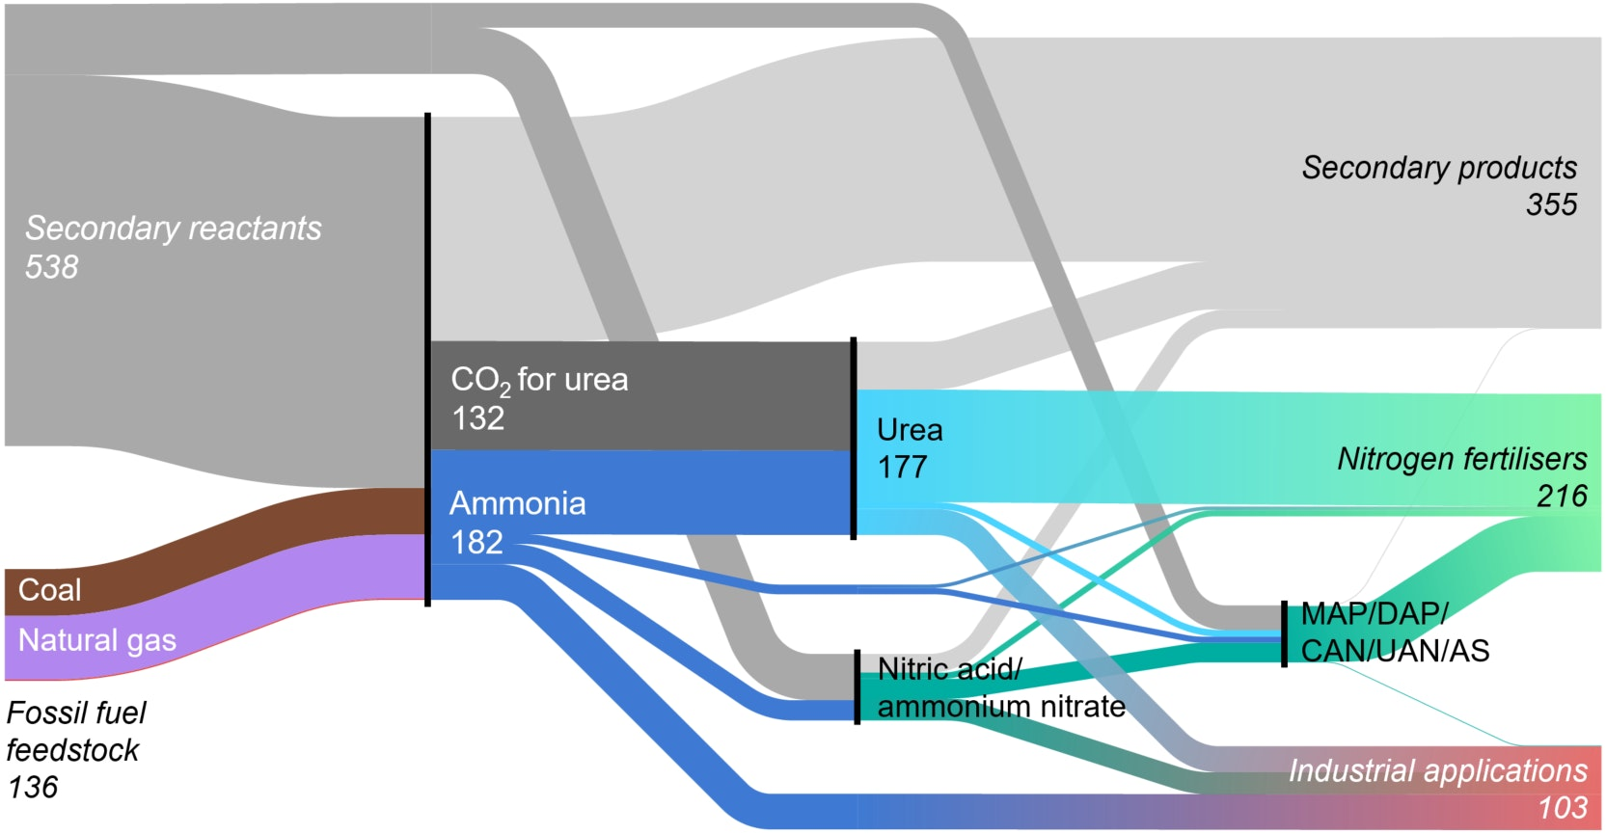
AMMONIA IS ESSENTIAL FOR AGRICULTURAL SYSTEMS THROUGH ITS USE FOR FERTILISERS
70% of ammonia is used for fertilisers
Between 1.9 and 2.6 tons of CO₂ are generated for every ton of ammonia produced
In 2020, global ammonia production accounted for 1.2% of global emissions
SOURCE: IEA, 2021

Slide 5
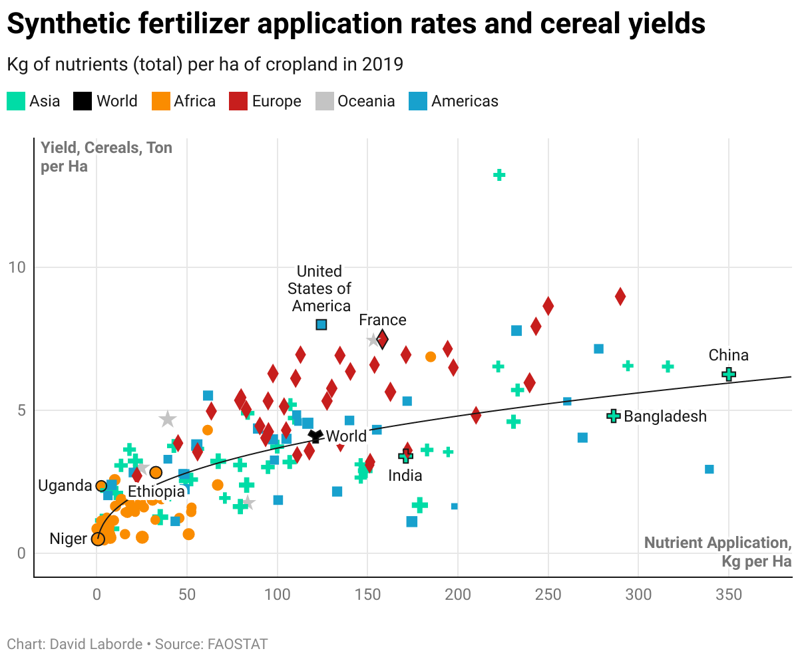
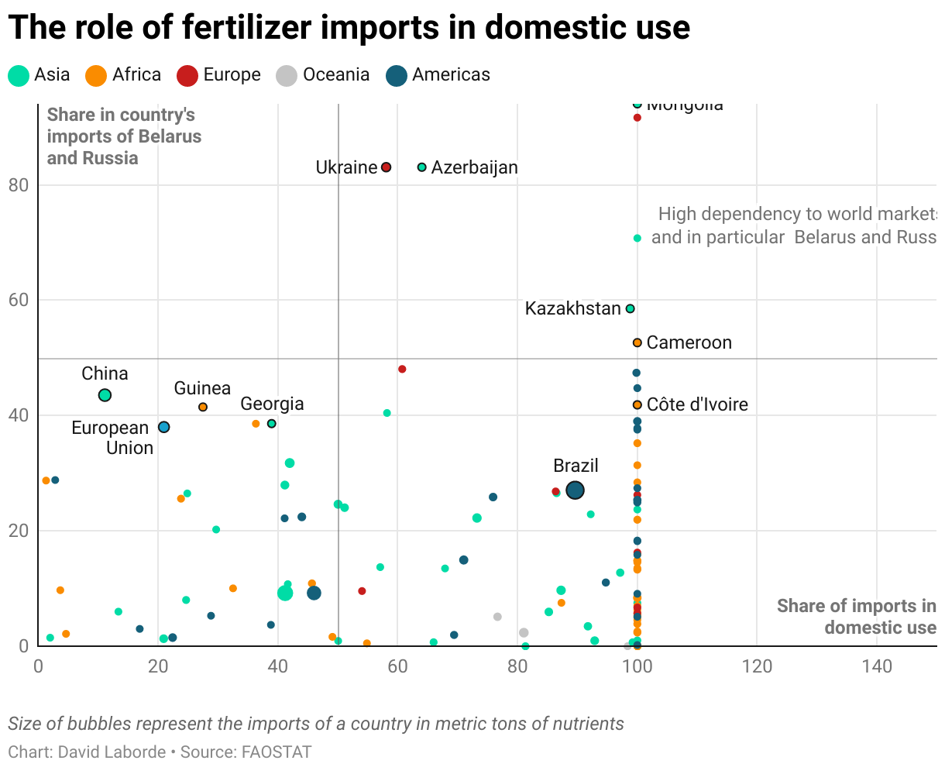
FERTILISER USE IN AFRICA REMAINS LOW AND HEAVILY RELIANT ON IMPORTS

Slide 6
KEY TAKEAWAYS
Africa has abundant renewable energy resources for producing green fertilisers, particularly green ammonia.
Domestic green ammonia production can reduce dependence on imported fertilizers and enhance agricultural yields, boosting food security.
Countries have different starting points and industrial capabilities, with Morocco and Egypt as key players and Namibia as a newcomer.
Strong demand is needed to offset high initial capital costs for green hydrogen and fertiliser facilities
An integrated hydrogen strategy is essential, aligning industrialisation, agriculture, and investment to leverage synergies across sectors.

Slide 7
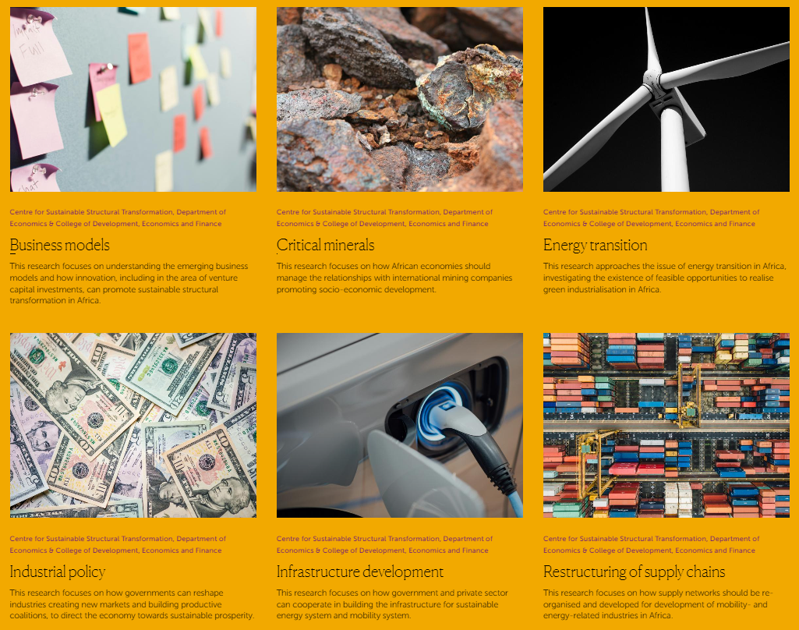
reimagining and promoting structural transformation in an age of ecological and social crises through industrial policy that is long-term-oriented and frame-shifting.

